Slide 1
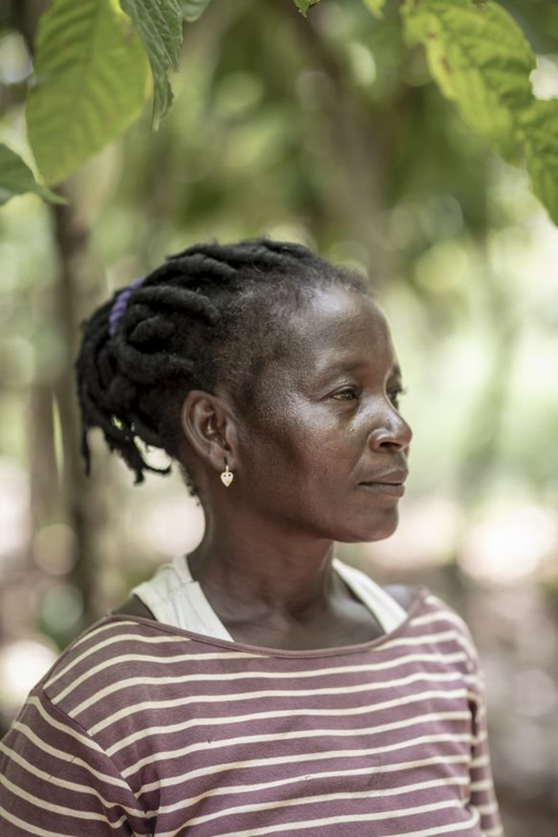
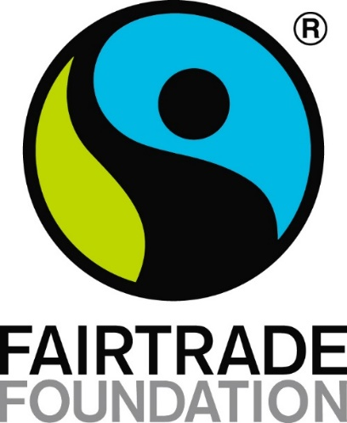
THERESE’s STORY
Notes:
This is the story of a cocoa farmer called Therese, who lives in a country in West Africa called Côte d'Ivoire.
(Photos © Chris Terry)

Slide 2
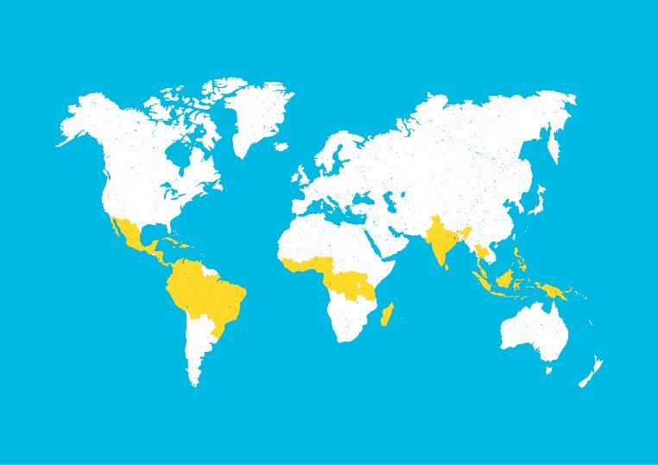
Notes:
Côte d'Ivoire is the world’s largest producer of cocoa, which is the special ingredient in chocolate. There are millions of farmers in Côte d'Ivoire who work hard to grow, harvest and prepare the cocoa beans before they are shipped to factories to be made into chocolate bars across the world.

Slide 3
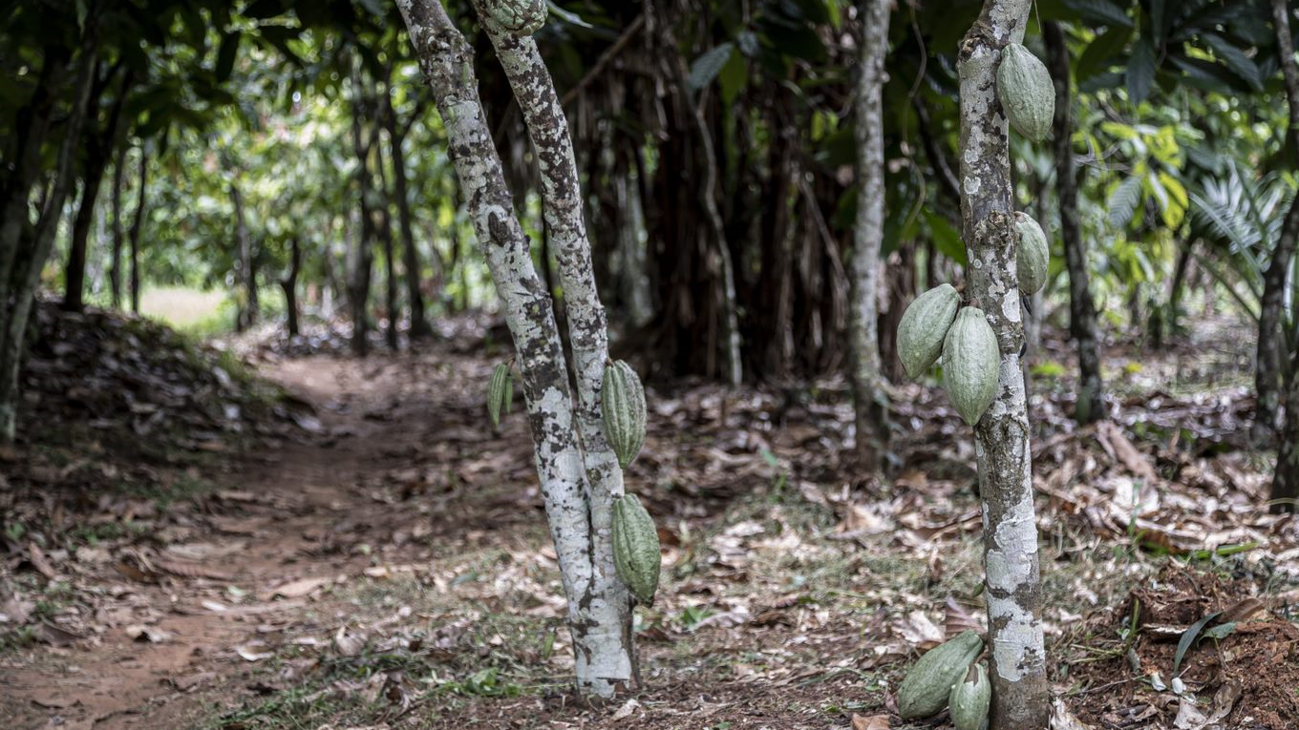
74p
Notes:
Even though cocoa farmers work very hard, the average cocoa farmer in Côte d'Ivoire earns just 74p a day. This means that farmers are not able to meet their family’s basic needs.

Slide 4
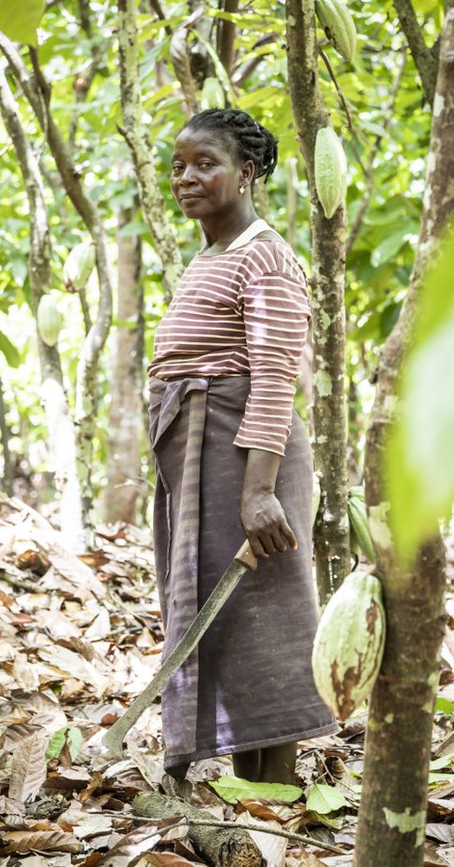
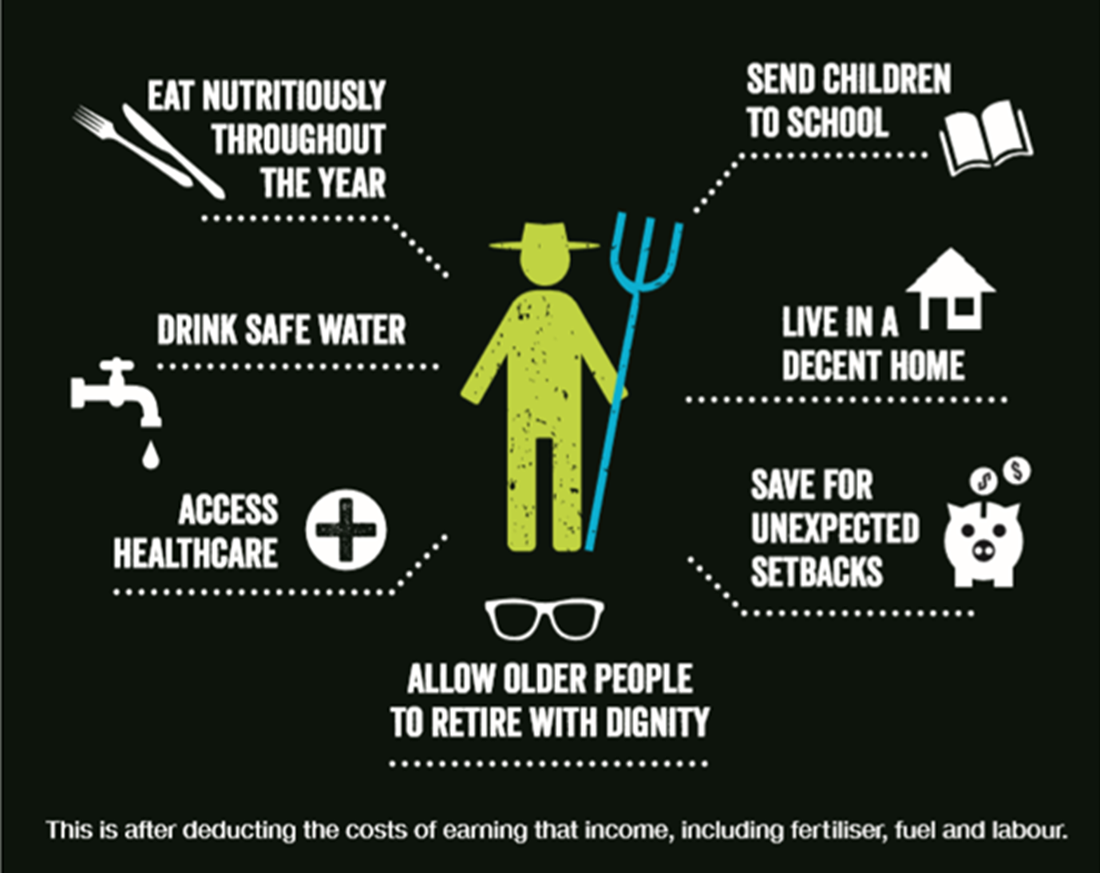
Notes:
These are some of the basic needs that farmers need to pay for. Do you think that it is possible to pay for all of these things with 74p?

Slide 5
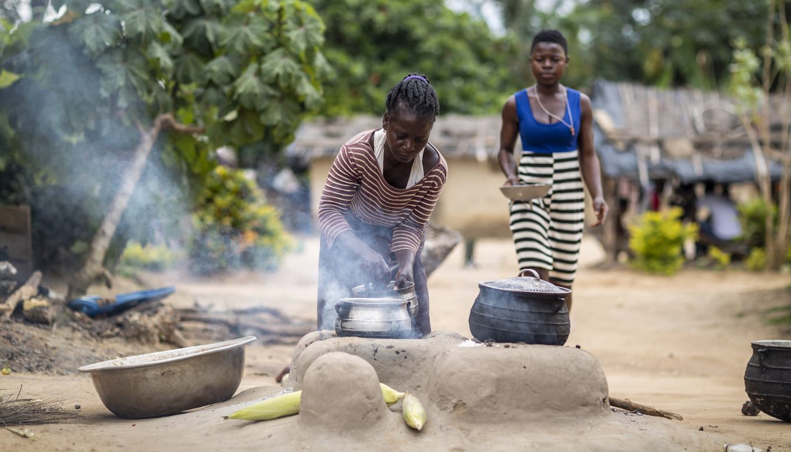
Notes:
When Therese was a little girl, her family didn’t have enough money to send her to school. Sometimes her parents didn’t have enough money to pay for food, so she went hungry.
Now that Therese is grown up, Therese has eight children of her own. She wants her children to be happy and healthy, and wants to earn enough money to meet her children’s basic needs.

Slide 6
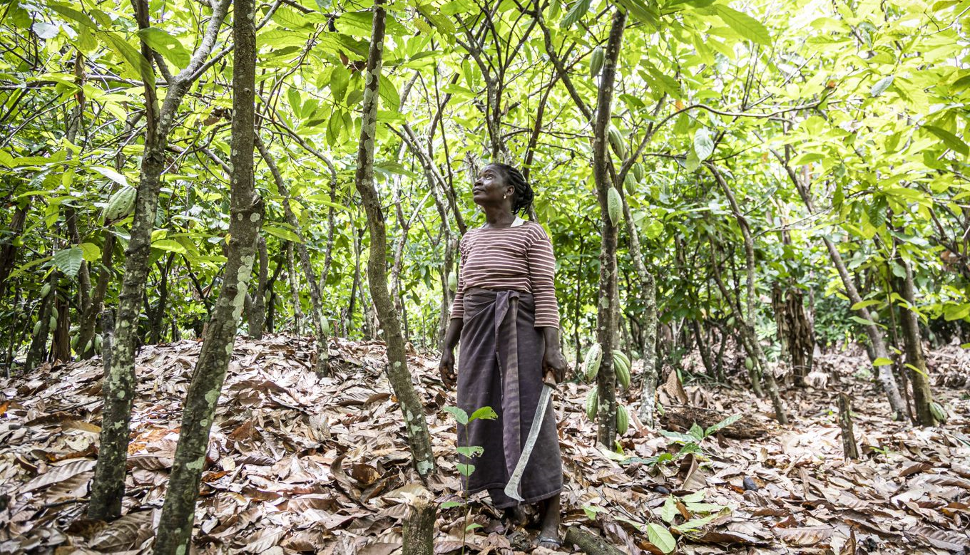
Notes:
Therese joined a Fairtrade cocoa farming cooperative which has means she is paid a better price for her cocoa beans. Because of Fairtrade, Therese and her husband can pay for their children’s school fees, books and lunch at school.
Therese and her children deserve to have a happy and healthy life, and to earn enough money to meet their basic needs.

Slide 7



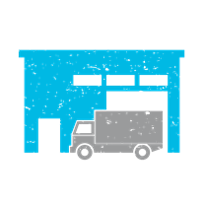
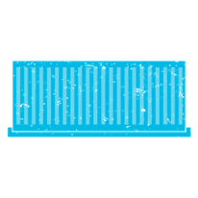





SUGGESTED FOLLOW-UP ACTIVITIES
Discuss: What an be done to ensure the basic needs of all farmers and workers are met?
All children have the right to an education. If you like , you could look at the UN Convention on the Rights of the Child and think about how Fairtrade promotes human rights
Notes:
Photo Credits
Dominique Fofanah

