Slide 2
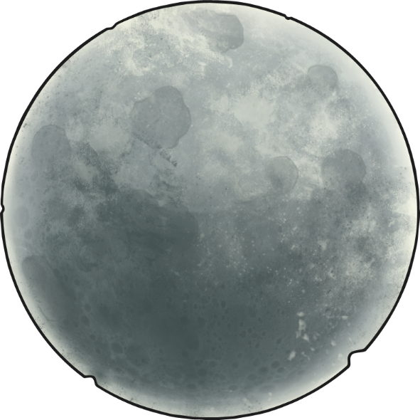
The Moon
Why can we see the Moon in the sky at night?
Why does the Moon look different at certain times?
Can the Moon ever be seen in the day?
Talk about it

Slide 3
What Is the Moon?
Earth’s moon is not a planet but is a satellite which orbits Earth. It is around a quarter of the size of Earth, with a diameter of 3,476km.
Scientists aren’t sure exactly how the Moon was
formed, although the main theory is that around
4.5 billion years ago, a body the size of Mars crashed in to Earth. The debris from this crash is believed to have formed the Moon.
The Moon has a thick outer layer of hard rock and is covered in regolith, Moon soil.
satellite – A body in space that orbits a planet.

Slide 4
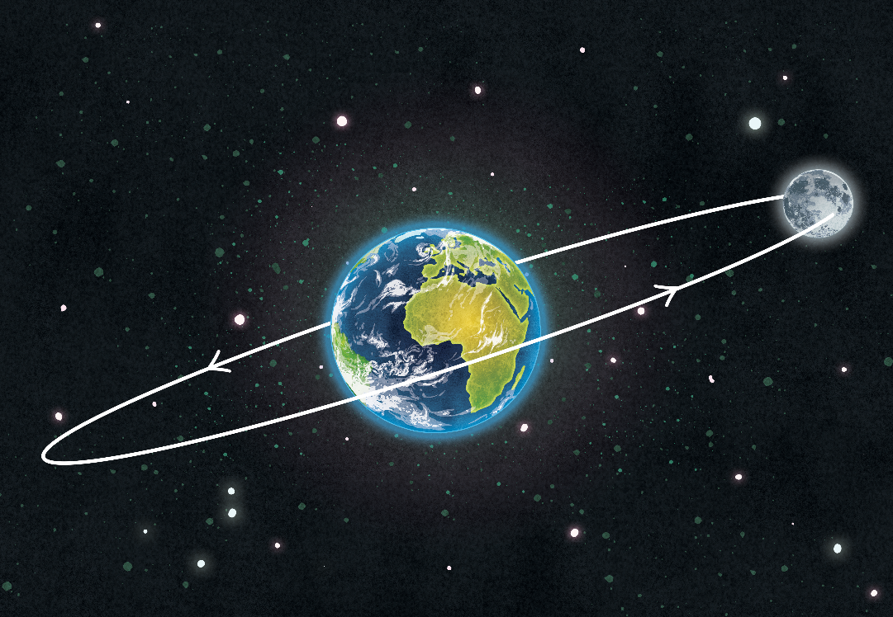
The Movement of the Moon - Orbit
The Moon orbits the Earth once every 27.3 days.
The Moon orbits the Earth in
an oval-shaped path called an ellipse. Because of this shape,
the Moon is sometimes nearer
and sometimes further away
from Earth. The range of
distance is from 364,397 km
to 406,731 km.

Slide 5
The Movement of the Moon - Rotation
Just like the Earth, the Moon rotates
on its axis. This rotation is anticlockwise,
just like the Earth’s.
It takes 28 days for the Moon to rotate once.
Because the Moon spins and orbits at
the same rate of time, it appears to be
still from Earth. Scientists call this
‘synchronous rotation’. The word ‘synchronise’ means that things happen
at the same time.

Slide 6
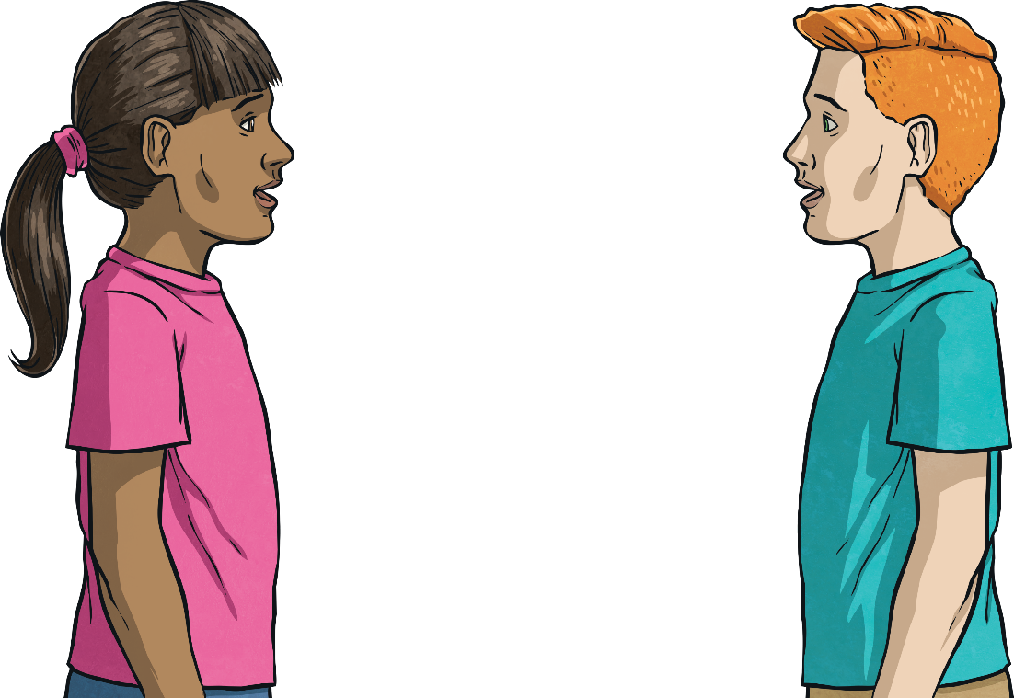
The Far Side of the Moon
The Earth and the Moon both rotate for the same length of time. This is called tidal locking. Because of this tidal locking, we only ever see one side of the Moon from Earth.
With a partner, try acting out tidal locking. One of you will be the Earth and the
other will be the Moon.
Face each other. The ‘Earth’ should
turn round slowly. The ‘Moon’ should
walk round the ‘Earth’ at the same
speed that the ‘Earth’ is spinning.
Keep facing each other.

Slide 7

The Far Side of the Moon
The side of the Moon we can see is called the near side. The other side of the Moon, the side we can’t see, is called the far side (although people often refer to it as the dark side of the moon, this is not accurate as there is no side of the Moon which is constantly in darkness). In 1959, the Russian spacecraft Luna 3 took the first photographs of the far side of the Moon. Until that time, no one knew what it looked like.
The far side of the Moon is very different to the near side. It is covered in craters from meteors that have crashed into it.

Slide 8

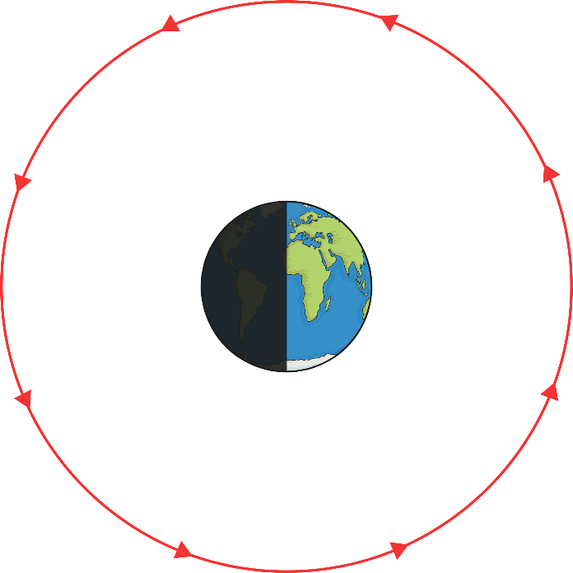
The Shape of the Moon
At various times in a month, the Moon looks different. This is because as the Moon rotates round the Earth, the Sun lights up different parts of it.
sunlight

Slide 9
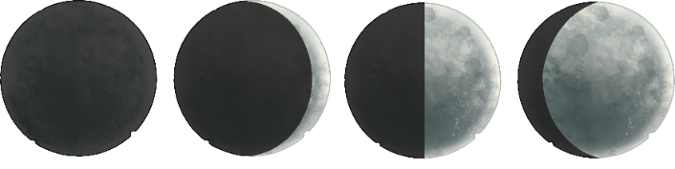
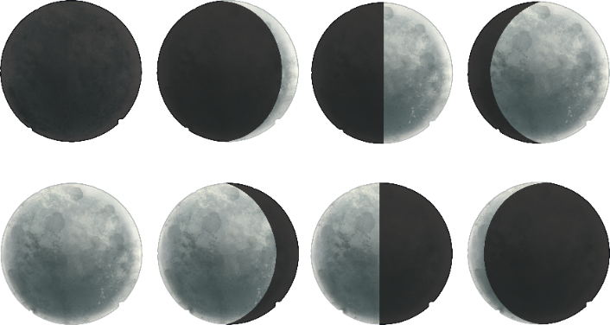
Waxing and Waning
The Moon can be described as either waxing or waning. This refers to the amount of Moon we see on sequential days.
When we are gradually seeing more of the Moon over a number of days, this is called waxing.
waxing
When we are gradually seeing less of the Moon over a number of days, this is called waning.
waning

Slide 10
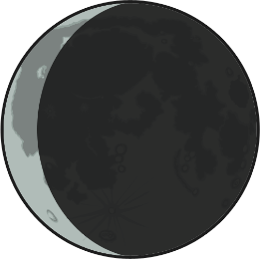
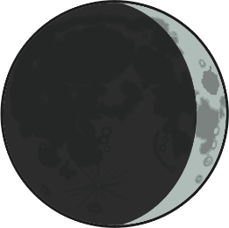
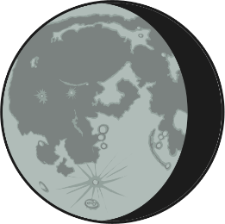
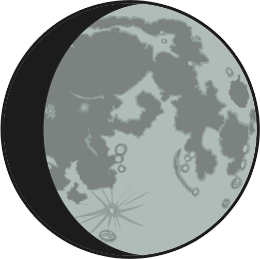
Crescent and Gibbous
A crescent moon is when we can only see a crescent-shaped area of the Moon.
waning crescent moon
waxing crescent moon
A gibbous moon is when a crescent-shaped area of the Moon cannot be seen.
waning gibbous moon
waxing gibbous moon

Slide 11




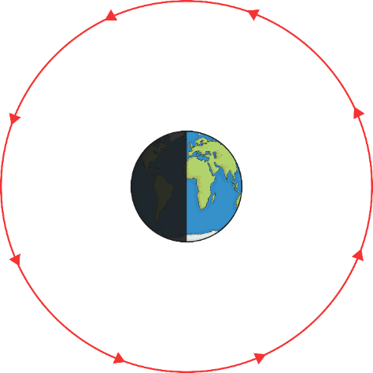






Phases of the Moon
The Moon can also be described as a new moon (when none of it is visible from the Earth), half-moon and full moon.
Waxing Half Moon
Waxing Gibbous
Waxing Crescent
sunlight
full moon
new moon
Waning Gibbous
Waning Crescent
Waning Half Moon

Slide 12
What Can You Remember?
Can you guess the missing words?
orbits
days
The Moon the Earth once every 27.3 .
When we can gradually see more of the Moon, it is called .
When we can gradually see less of the Moon, it is called .
waxing
waning

