Slide 2
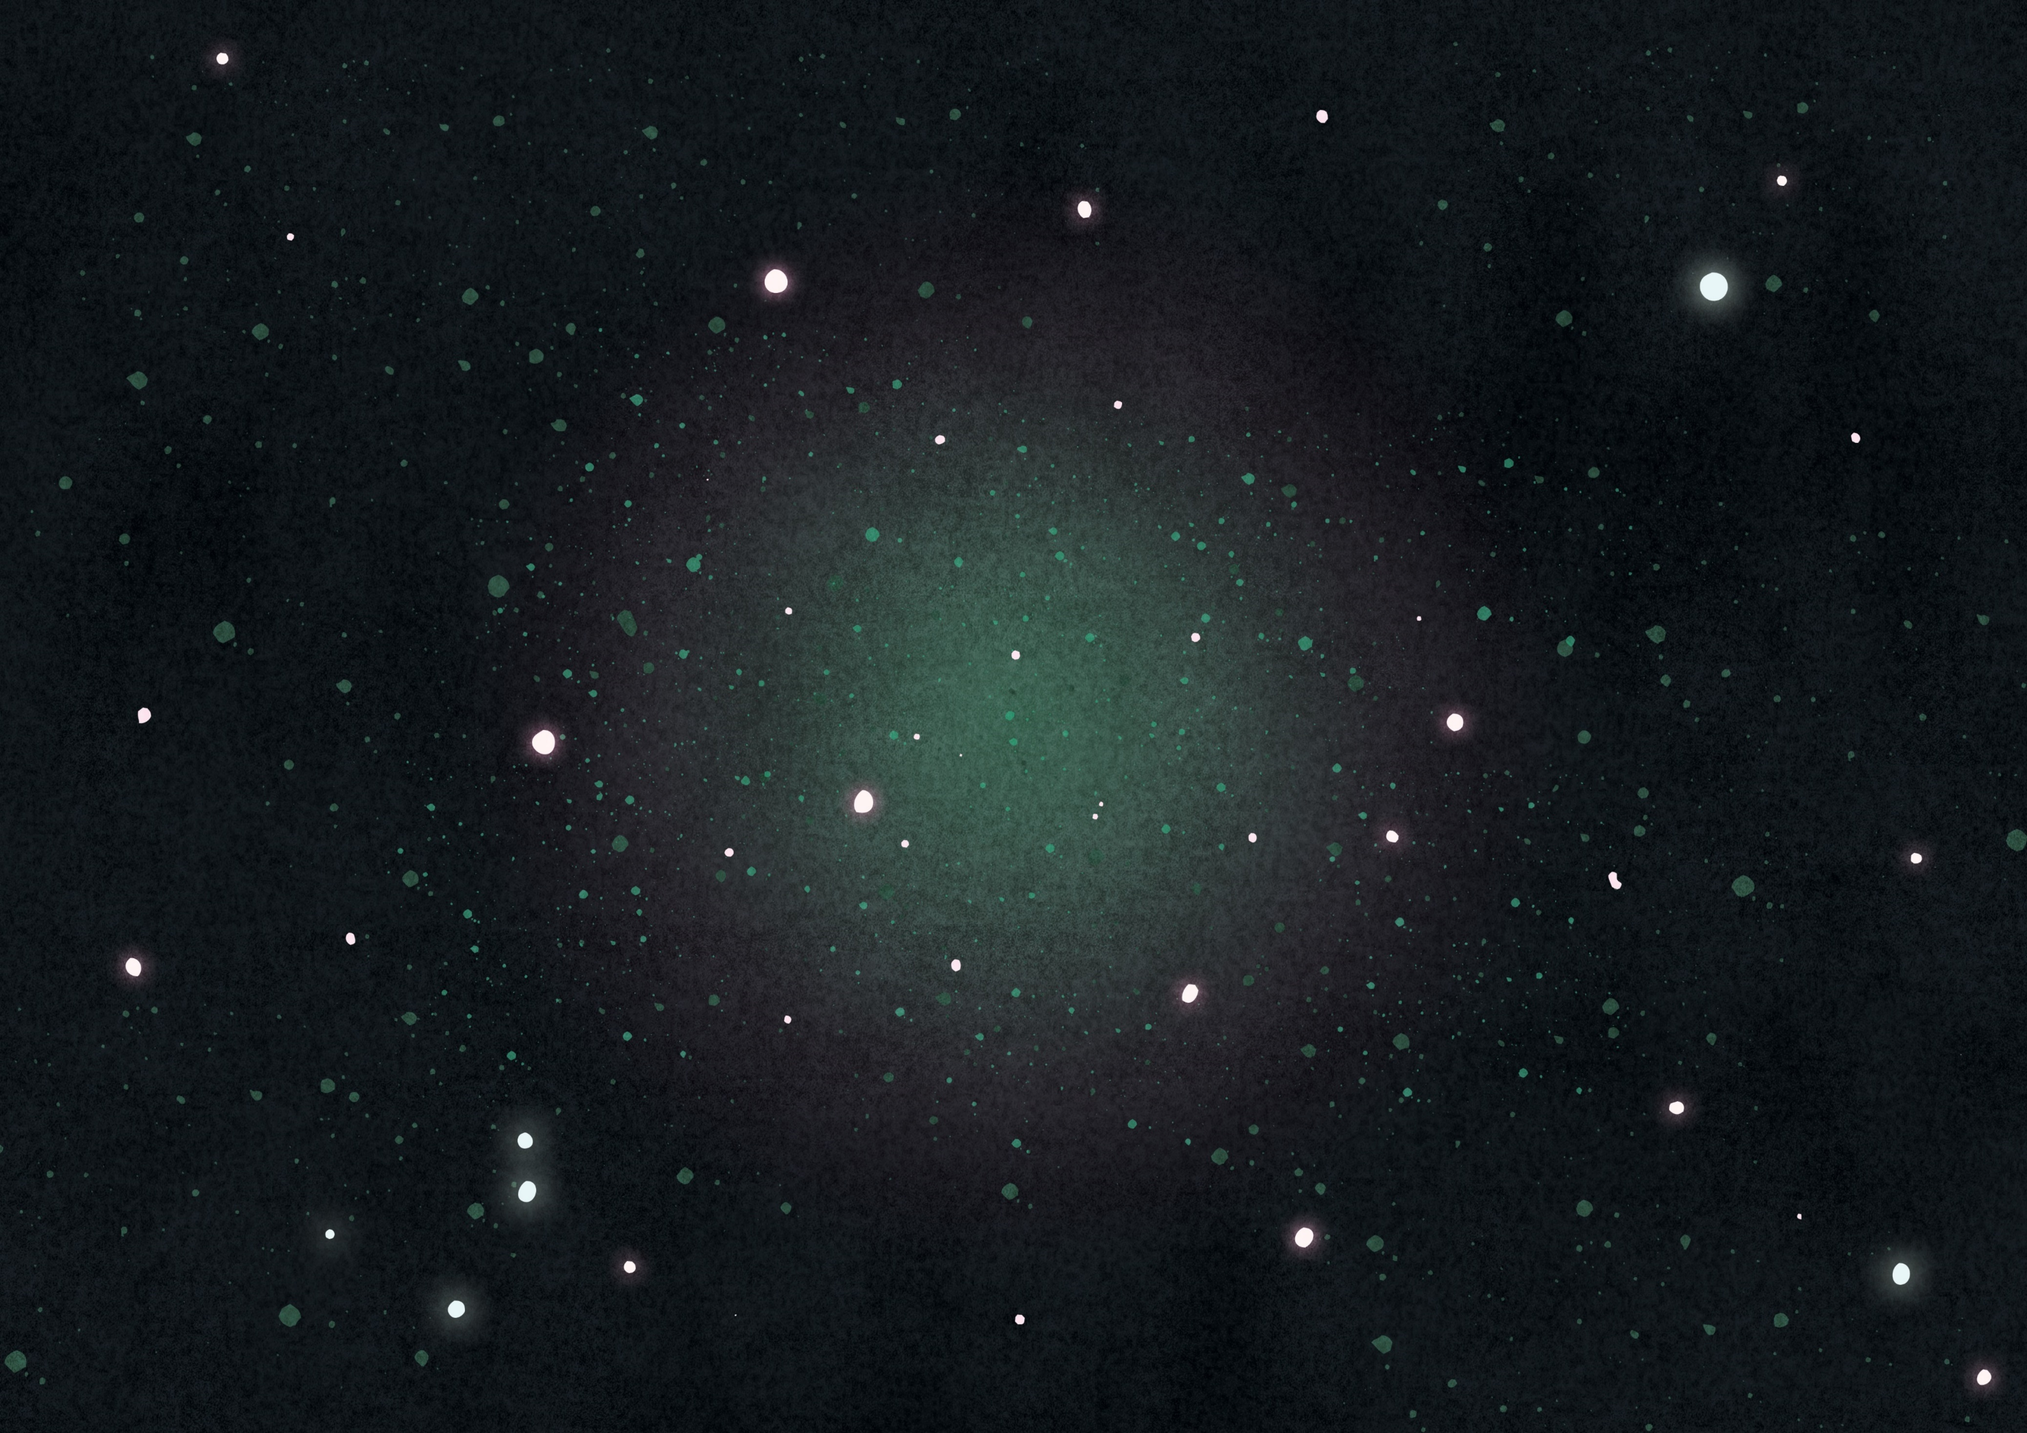
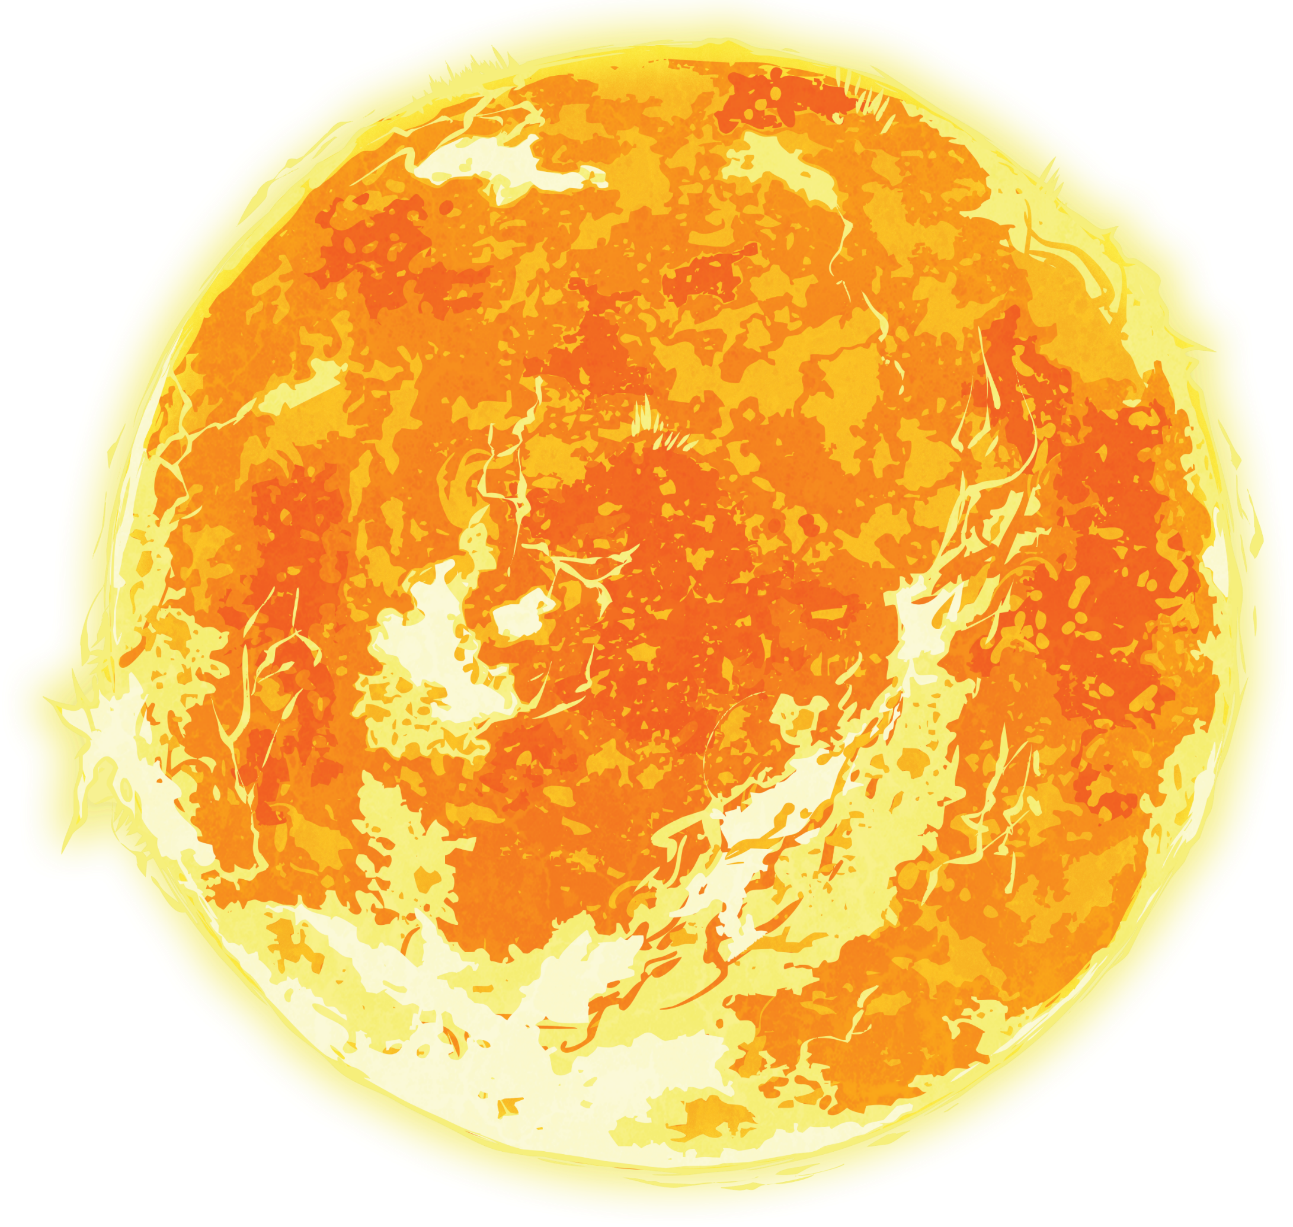

The Solar System
The Solar System
twinkl.com

Slide 3
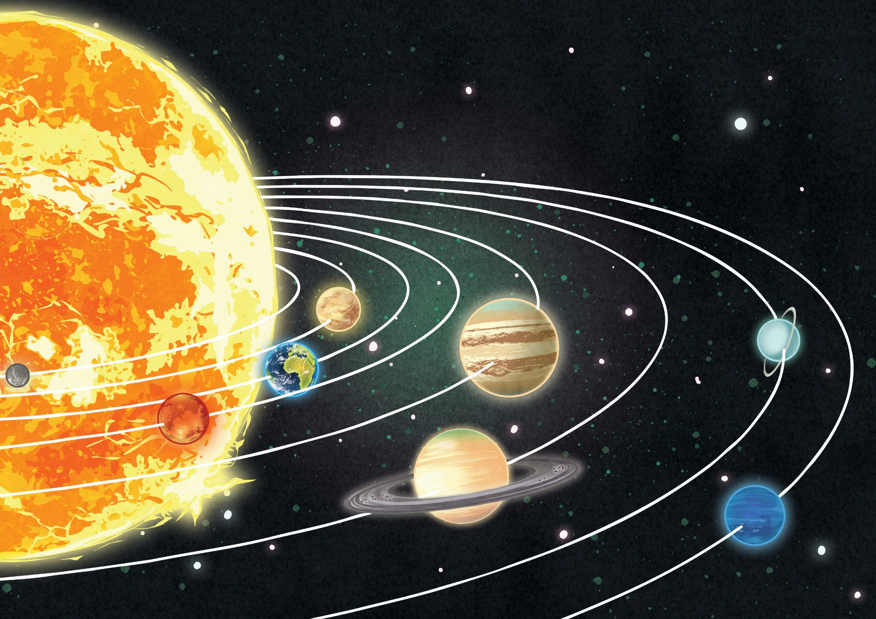
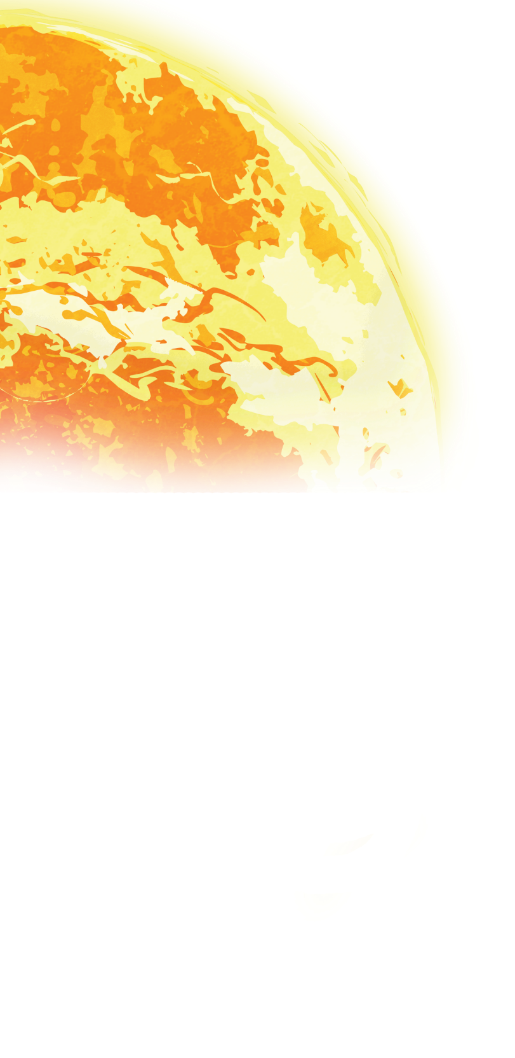
We live on planet Earth which is one of eight planets in our solar system. Our solar system is a collection of eight planets and their moons which orbit the Sun; along with asteroids, comets and meteoroids (which we may see as shooting stars).
twinkl.com

Slide 4

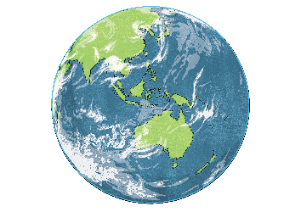
An orbit is the path that celestial bodies or satellites follow (like planets and moons) as they revolve around another body. The force of gravity causes this.
The object in orbit will always be much smaller than whatever it is orbiting as it is the larger object that has more gravitational pull.
Orbit

Slide 5
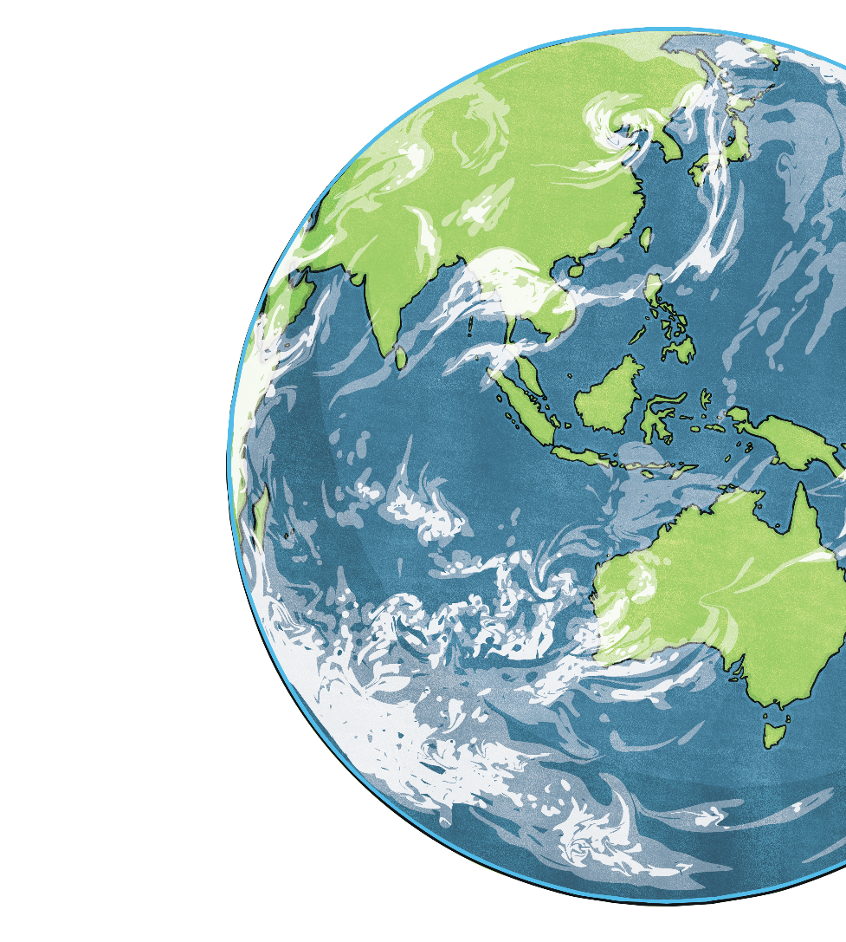
Planet Earth
Our home is Earth which is a planet. A planet is a body which orbits a star and the closest star to us is the Sun, which planet Earth orbits.
Earth is the third closest planet to the Sun and is the fifth biggest planet in the solar system.
As with other planets and stars, the earth is round. This is caused by gravity pulling on the surface towards the centre of the plane.

Slide 6
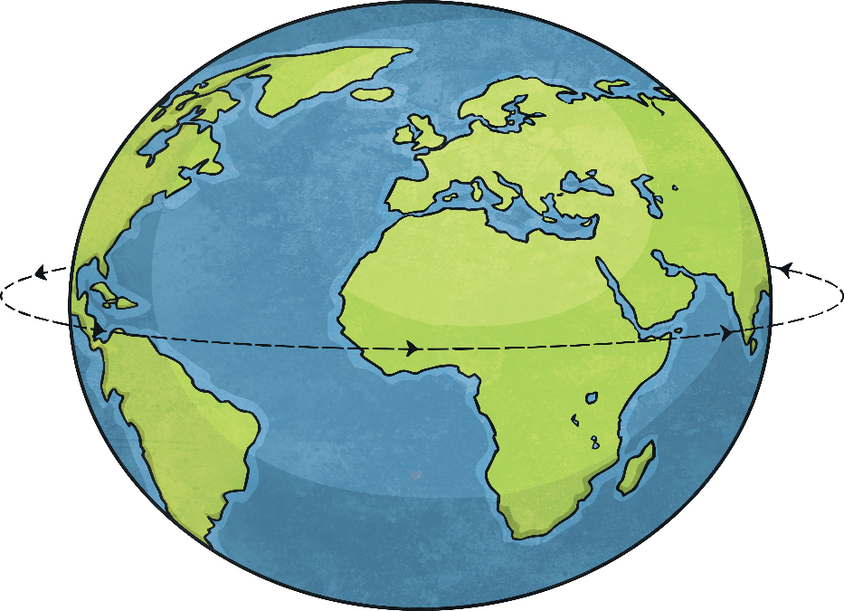
Although the earth is round, it is not a perfect sphere. It’s actually an ‘oblate spheroid’. This just means it’s not the same diameter all the way around, in fact it’s a little larger around the equator.
Can you think why this is?

Slide 7
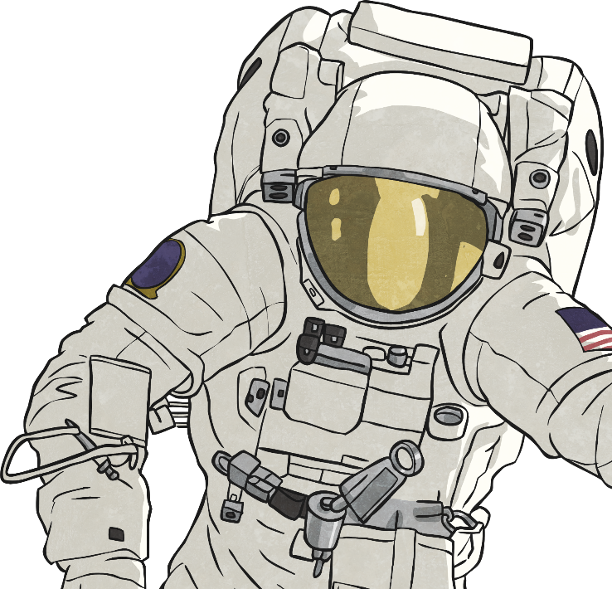
The Earth orbits the Sun. How long do you think it takes the Earth to orbit the sun once?
*Hint* think about our calendar.

Slide 8
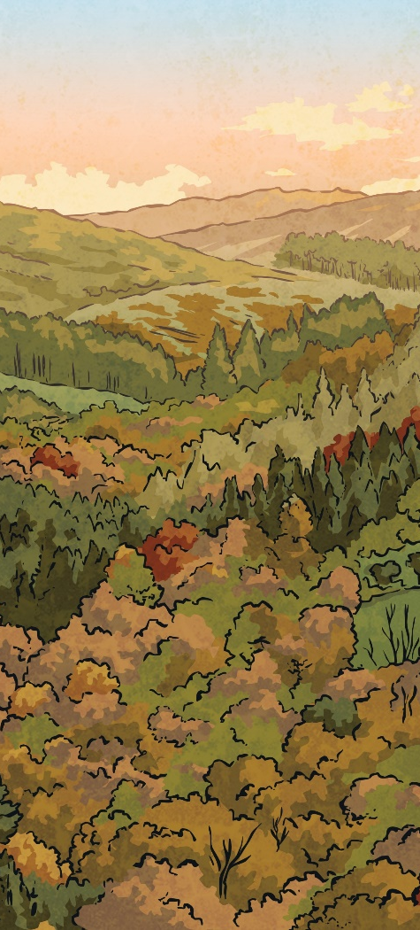
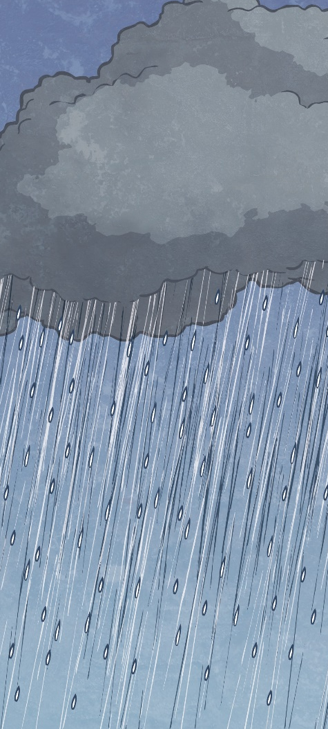
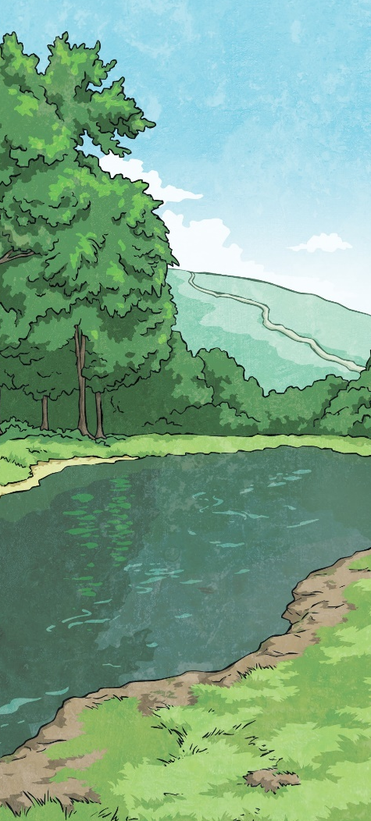
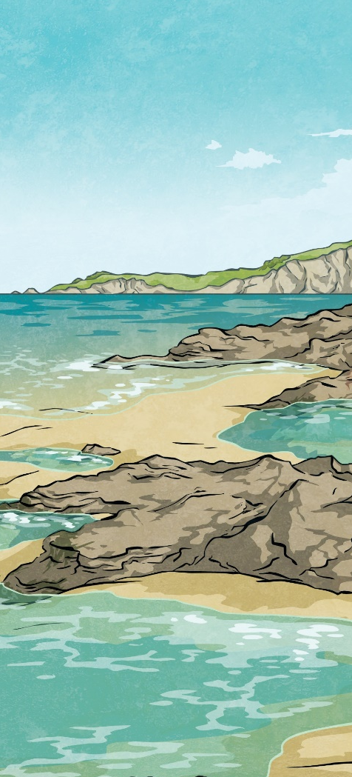
Seasons
Planet Earth takes 365 days (and 6 hours!)
to orbit the sun once.
Have you ever wondered why we have different seasons? This is because of Earth’s tilt.
At different times of the year the Sun’s light is shining on different parts
of Earth, making
it warmer.
Why do you think there is snow at the North and
South Pole?

Slide 9
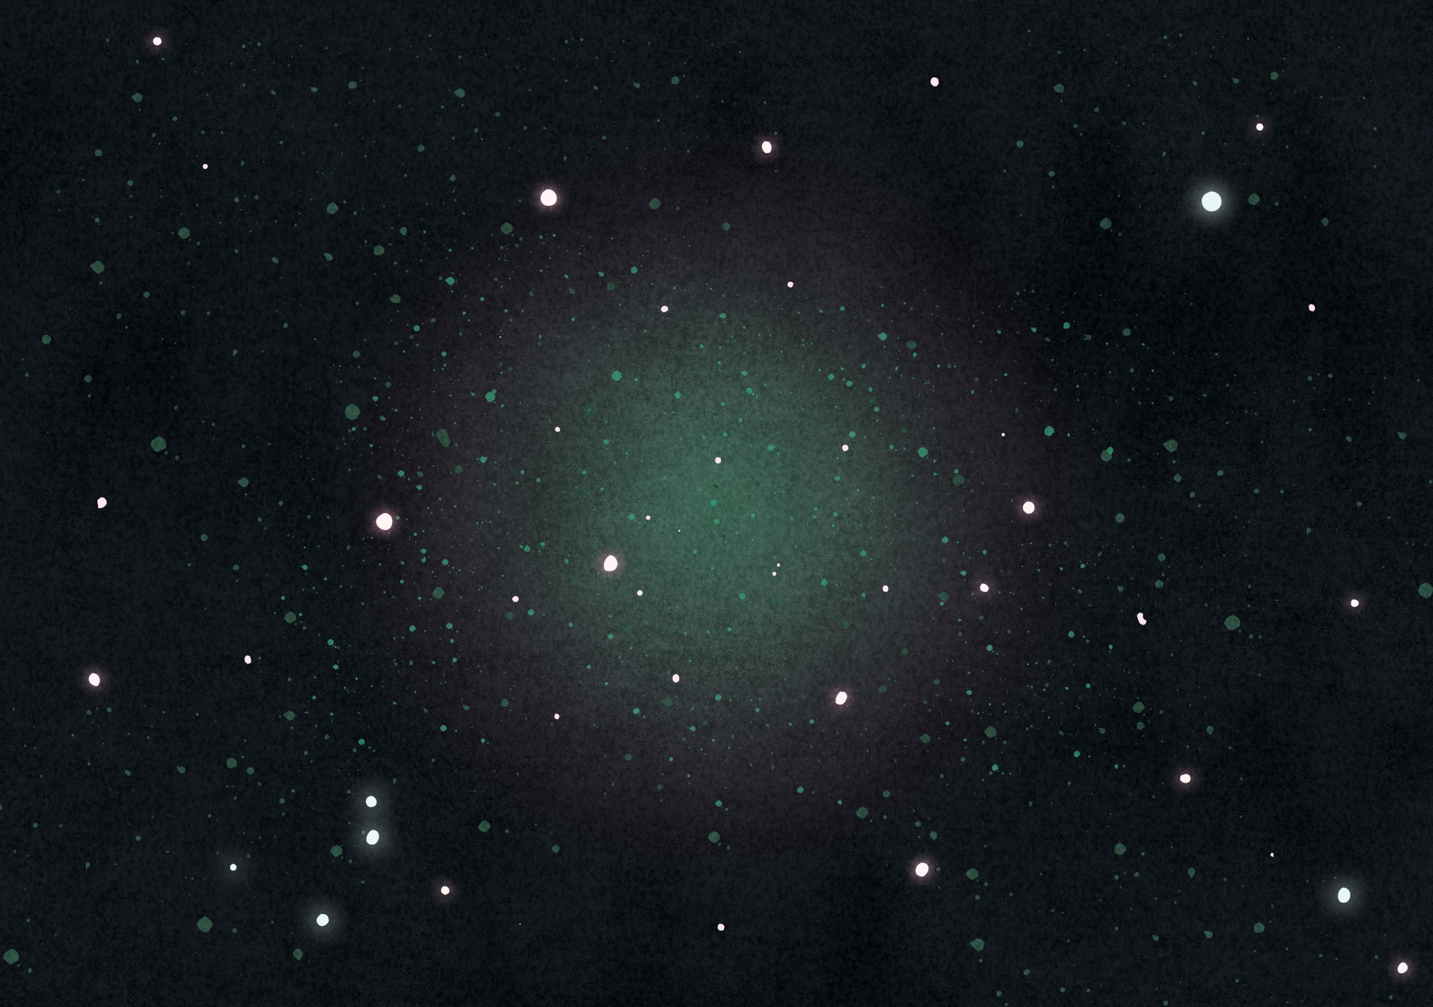


Autumn
Spring
Winter
Summer
Summer
Winter
Spring
Southern Hemisphere
Autumn
Northern Hemisphere

Slide 10
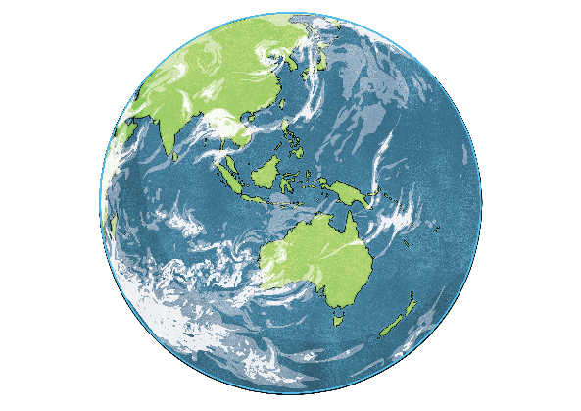

Summer in the Southern Hemisphere is caused by more direct sunlight shining on to it.
North Pole
North Pole
Japan
Suns Rays
Japan
Suns Rays
Equator
Australia
South Pole
Equator
Australia
This shows that while it is summer in the Southern Hemisphere it is winter in the Northern Hemisphere. There is more sunlight shining on Australia, which is in the Southern Hemisphere.
South Pole
Japan (in the Northern Hemisphere) is in winter while Australia, which is almost directly below but in the Southern Hemisphere, is in summer because it has more sunlight shining on it.

Slide 11
This shows Australia in winter and Japan in summer. Now there will be more sunlight shining on the Northern Hemisphere.
North Pole
Japan
Equator
Suns Rays
Australia
South Pole

Slide 12




The Sun
Size
In the very centre of our solar system is the Sun, which is about 1.3 million times as big as planet Earth.
The diameter of the Sun is about 1.391 million km, where the Earth is only 12,742 km.
Earth

Slide 13
The Sun – Stars in the skies
Just like all the stars we can see in the night sky, our Sun is also a star. The stars that we see at night are just a lot, lot further away. The closest stars are about four light years away (a light year is the distance that light can travel in a year – this is such an unbelievably large distance it is hard to imagine). A star is a huge ball of burning gas which is held together by gravity. They are a light source as they produce their own light.

Slide 14
The Sun is at the centre of our solar system and is orbited by eight planets, Earth being one of them.
Due to the Sun’s immense size it has a huge gravitational pull. This force keeps all the planets in our solar system in orbit.
twinkl.com

Slide 15
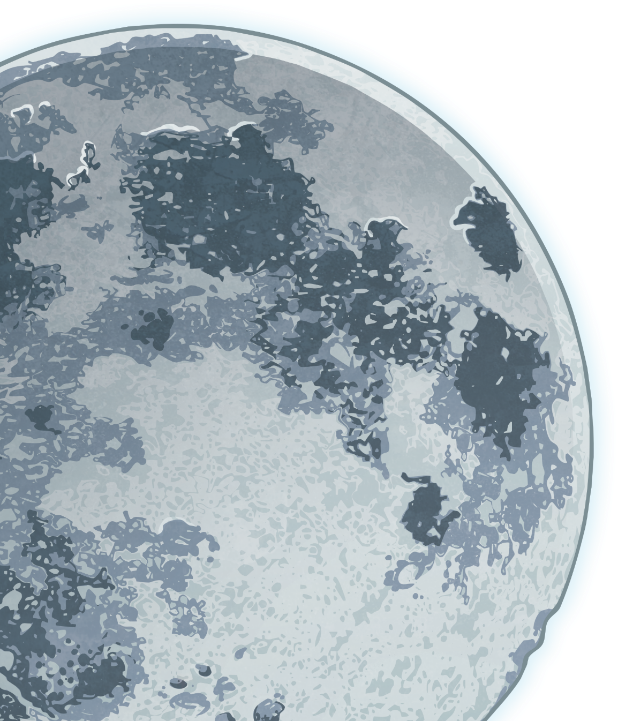
The Moon
A ‘moon’ is the name of a body which orbits another body, as long as it is not a star.
Earth has its own moon which can be seen on any clear night. Just like how the Earth orbits the sun, the Moon orbits Earth.
Mercury and Venus are the only planets in the solar system which don’t have any moons at all (Saturn has 62 moons!).

Slide 16
The Moon
At night the Moon gives us light, but it isn’t a light source like the Sun. It actually reflects the light from the Sun. Sometimes the Earth reflects light onto the moon. This is called ‘Earthshine’, and is why we can sometimes see the Moon during the daytime.

Slide 17


The Moon
Looking at the Moon from Earth, it looks like it keeps changing shape. Can you think of why this might be?

Slide 18
The Moon
The best way to show how we see different phases of the Moon is by shining a torch on a ball in a dark room. As you move the torch around the ball, you will see different shadows.
Remember that the Sun (the torch) does not move, it just helps for this little experiment as it is just the shadows you are looking at.

Slide 19
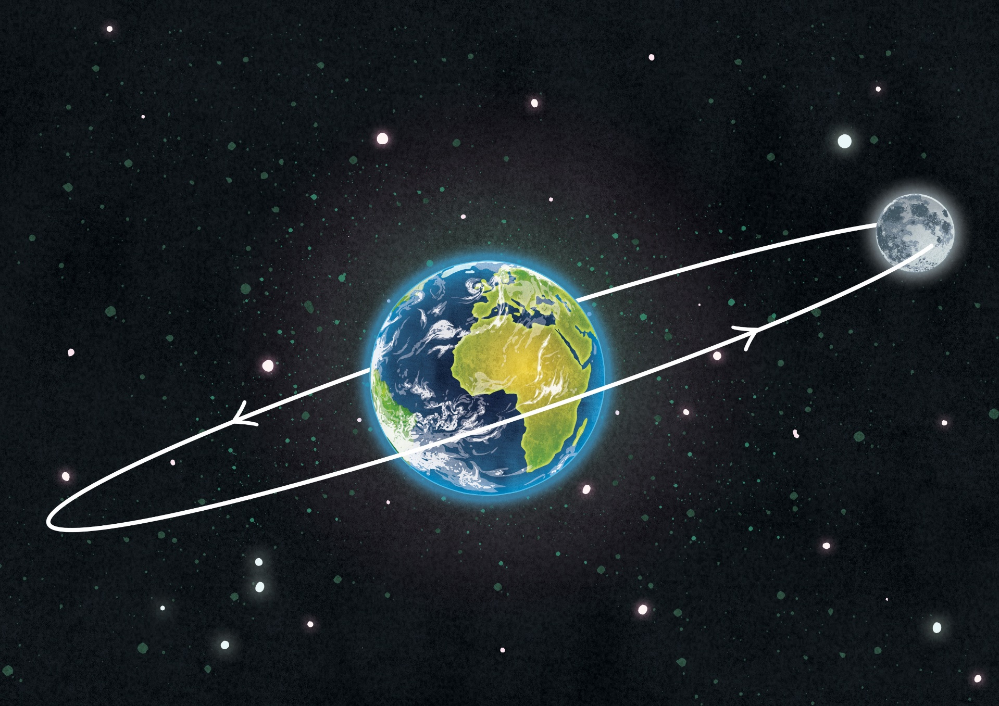
The Moon’s Orbit
The moon takes 27 days (and 8 hours) to orbit the Earth. The Moon has an elliptical orbit rather than a circular orbit, which means it orbits the Earth in an egg shape.
As a result, the distance from the Earth to the Moon varies from 363,104 kilometers to 405,696 km.

