Slide 1
States of Matter Introduction Solids, Liquids and Gases

Slide 2

Starter: What Is Matter?
Everything is made up of matter.
So what is matter?
How do we know it exists?

Slide 3

Matter
Everything is made up of matter.
Matter is any substance that has mass
and takes up space (volume).
Your desk is made of matter.
Your pencil is made of matter.
You are made of matter!

Slide 4

Matter
There are five states of matter.
You will learn about three of these in KS2 Science.
The 3 states of matter you need to know are:
solid
liquid
gas

Slide 5

Properties of Types of Matter
What makes a solid different from a liquid, or a gas?
These features are called properties.
(In science this doesn’t mean a house!)
For example:
hard, soft, can flow, invisible.
You have already used some properties to successfully identify solids, liquids and gases around you

Slide 6


Properties of Types of Matter
What makes a solid different from a liquid, or a gas?

Slide 7


Properties of Types of Matter
You are going to describe the properties of the three states of matter: solids, liquids and gases.
Points to include:
What does it feel like?
What does it look like?
Can you squash it? Pour it?
Plus anything else you can think of!
Not sure where to start? Imagine you were describing your state of matter to an alien from outer space!
Challenge:
Can you write your description in 20 words or less?

Slide 8
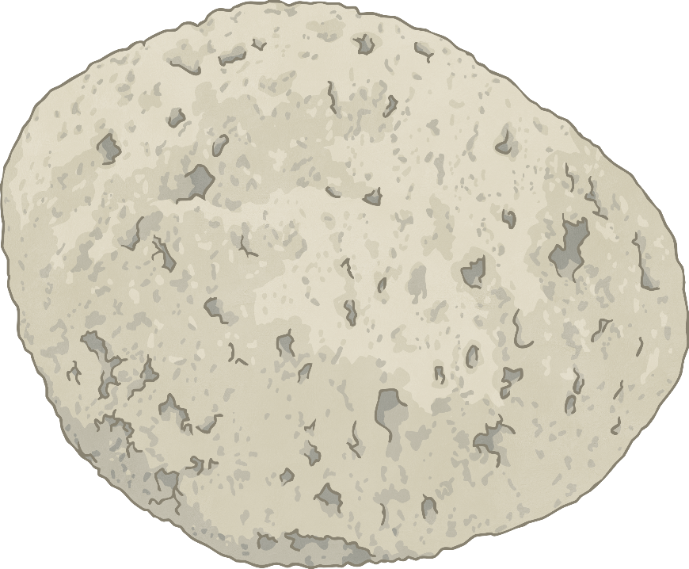
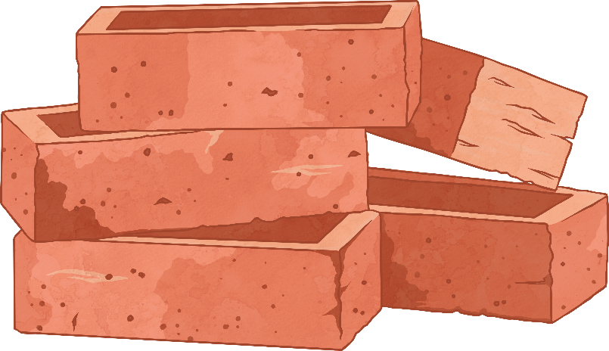
Properties Key Points: Solids
Have a fixed shape.
Cannot be squashed (compressed).
Cannot flow.
Particles cannot move, but can vibrate on the spot.

Slide 9
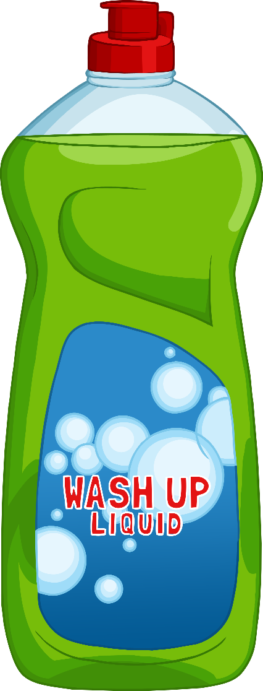
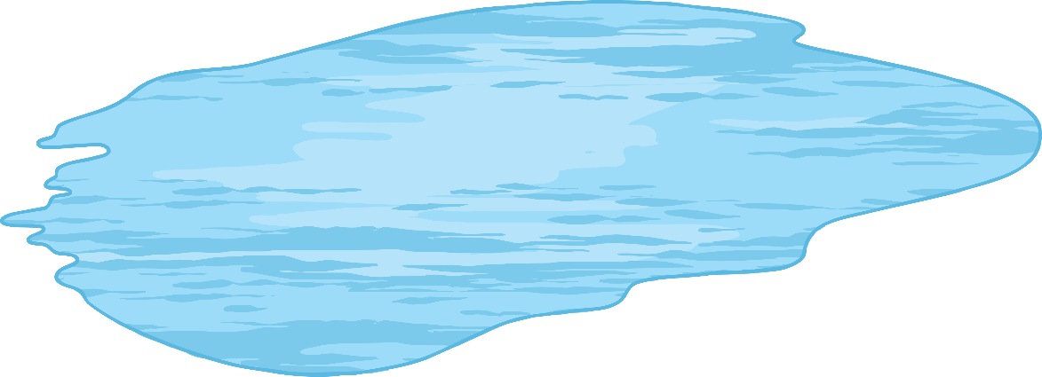
Properties Key Points: Liquids
No fixed shape - takes the shape of the container.
Cannot be squashed (compressed).
Can flow.

Slide 10
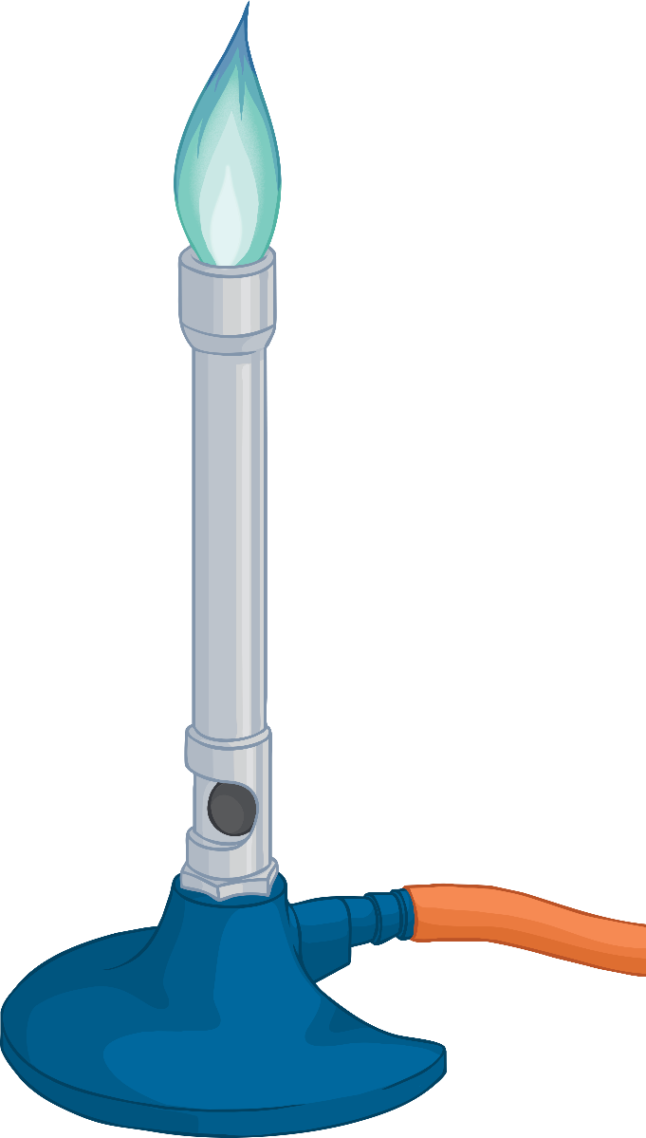
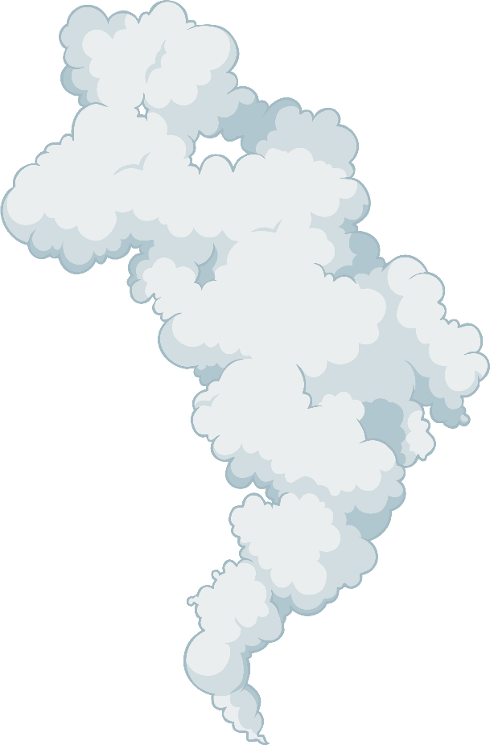
Properties Key Points: Gases
No fixed shape - takes the shape of the container.
Can be squashed (compressed).
Can flow.

Slide 11
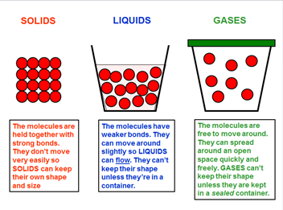

Slide 12
Read these sentences and say whether they relate to solids, liquids or gases.
My shape can be changed but my volume stays the same
My shape stays the same, unless a force is applied
I will spread out to fill any available space
My molecules are few and have no strong attraction
My molecules are many and are strongly attracted to each other
My molecules can move over and around each other but will
not split up completely
(Answers on next slide)

Slide 13
My shape can be changed but my volume stays the same (liquid)
My shape stays the same, unless a force is applied (solid)
I will spread out to fill any available space (gas)
My molecules are few and have no strong attraction (gas)
My molecules are many and are strongly attracted to each other (solid)
My molecules can move over and around each other but will
not split up completely (liquid)

