Slide 1
Q. What is the ratio of circles : triangles?
A. 8 circles : 4 triangles or 8 : 4
A. 2 circles : 1 triangle or 2 : 1

Slide 2
Q. What is the ratio of circles : triangles?
A. 8 circles : 4 triangles or 8 : 4
A. 4 circles : 2 triangles or 4 : 2
A. 2 circles : 1 triangles or 2 : 1

Slide 3
Q. What is the ratio of circles : rectangles in both patterns?
A. 9 circles : 6 rectangles or 9 : 6
A. 12 circles : 8 rectangles or 12 : 8
A. 3 circles : 2 rectangles or 3 : 2
A. 3 circles : 2 rectangles or 3 : 2
Q. Do they have the same ratio?
Lets simplify them and see…

Slide 4
Practise finding the ratios
Ratio (transum.org)
Simplifying Practice:
https://www.mathplayground.com/ASB_RatioBlaster.html
Ratio (transum.org)

Slide 5
Scaling-up:
Daniel Sturridge scores two goals to every five games. If he played 35 games, how many goals would he score?
Ratio = 2 : 5
(x7)
Unknown Ratio = ? : 35
New Ratio = 14 : 35
Scaling-up Practice:
http://www.mathplayground.com/wpdatabase/Ratio1_2.htm

Slide 6
B
A
2cm
8cm
5cm
20cm
Q. What is the scale factor?
Look at the relationship between the same sides e.g. A= 2cm, B= 8cm
2:8, simplified as 1:4. Scale factor is 4.

Slide 7
6cm
2cm
5cm
x cm
Q. What is the scale factor?
Q. What is the length of x?

Slide 8
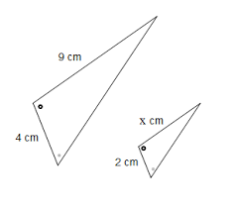
Q. What is the scale factor?
Q. What is the length of x?

Slide 9
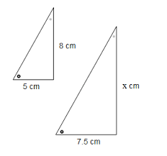
Q. What is the scale factor?
Q. What is the length of x?

