Slide 1
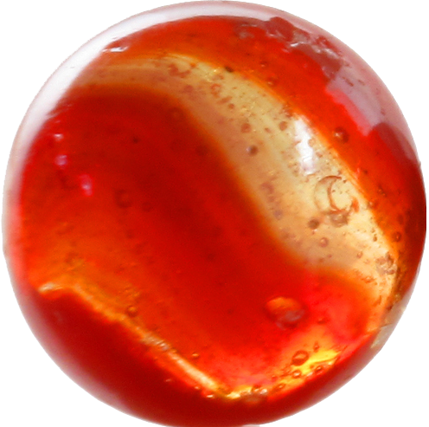
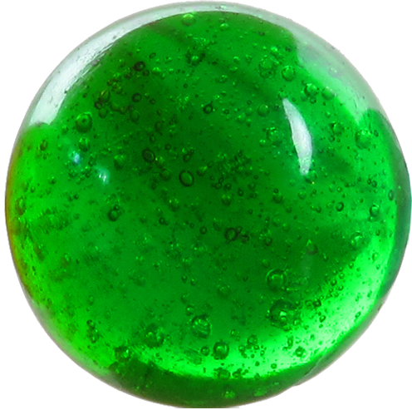
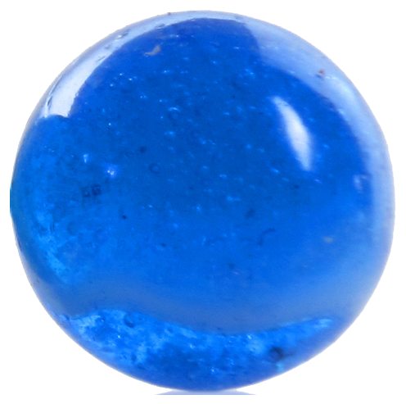
©Kellis (shutterstock 65833627)

Slide 2
Q1. What is the ratio of red marbles to the other colours?
6 : 10
3 : 5
Q2. What is the proportion of red marbles?
6 ‘out of’ 16 (6/16)
3 ‘out of’ 8 (3/8)
Q3. What is the ratio of red to blue to green marbles?
6 : 2 : 8
3 : 1 : 4
Q4. If there are 24 marbles in the same ratios, how can you work out how many of each colour there are?
How do we solve this using 3 : 1 : 4?
Turn the ratios into fractions (proportions).
The denominator is each of the ratio parts added together (3 + 1 + 4 = 8)
The numerator is the ratio part e.g. red = 3/8.
Red = 3/8 of 24 =
Blue = 1/8 of 24 =
Green = 4/8 of 24 =
9 red marbles
3 blue marbles
12 red marbles
How would we check our answers?

Slide 3
Let’s Practice:
• £60 divided in the ratio 2 : 3
• £100 divided in the ratio 1 : 4
• £30 divided in the ratio 11 : 4
• 60 kg divided in the ratio 6 : 5 : 1
• 75 kg divided in the ratio 12 : 8 : 5
• 108 kg divided in the ratio 3 : 4 : 5

Slide 4
Let’s Practice answers:
• £60 divided in the ratio 2 : 3 £24, £36
• £100 divided in the ratio 1 : 4 £20, £80
• £30 divided in the ratio 11 : 4 £22, 8
• 60 kg divided in the ratio 6 : 5 : 1 30kg, 25 kg, 5 kg
• 75 kg divided in the ratio 12 : 8 : 5 36kg, 24kg, 15kg
• 108 kg divided in the ratio 3 : 4 : 5 27kg, 36kg, 45kg

Slide 5
Chocolate Buns
To make 12 Chocolate Buns you need;-
100g margarine
120g caster sugar
2 eggs
150g self raising sugar
Find half the amount
and add it to the
original
Half the amount
To make 18 Chocolate Buns you need;-
g margarine
g caster sugar
eggs
g self raising sugar
To make 6 Chocolate Buns you need;-
g margarine
g caster sugar
eggs
g self raising sugar
150
50
180
60
3
1
225
75
I used 5 eggs
g margarine
g caster sugar
g self raising sugar
How many buns did I make?
2 ½ times
The original
amount
250
300
375
AHN2007

Slide 6
Potato Scones
To make 8 Potato Scones you will need;-
450g cooked potatoes
2.5ml spoon salt
50g butter
100g self raising flour
Add ½ again to the original
amount
Multiply by 4
To make 12 Potato Scones you will need;-
g cooked potatoes
ml spoon salt
g butter
g self raising flour
To make 32 Potato Scones you will need;-
g cooked potatoes
ml spoon salt
g butter
g self raising flour
675
1800
3.75
10
75
200
150
400
I used 250 g self raising flour
g cooked potatoes
ml spoon salt
g butter
How many Potato Scones did I make?
1125
2 ½ times the original amount
6.25
125
AHN2007

Slide 7
Breakfast Cereal
100g of Multigrain Hoops contains
6.5g protein
3.8g fat
4.6g fibre
78g carbohydrates
Multiply by 3
Divide by 2
300g of Multigrain Hoops contains
g protein
g fat
g fibre
g carbohydrates
50g of Multigrain Hoops contains
g protein
g fat
g fibre
g carbohydrates
19.5
3.25
11.4
1.9
13.8
2.3
234
39
I ate 195g carbohydrates
How much did I have of the following?
g protein
g fat
g fibre
How many grams of Multigrain Hoops
Divide the 100g amount by 20 to find 5%
Double the 100g amount then take away the 5%
16.25
9.5
11.5
AHN2007

