Slide 1
Pets
Key
own a dog
own a cat
own a hamster
own a fish
Q1) Why do we need a key for this pie chart?
Q2) What can you tell me about the information in this pie chart?
Q3a) If there are 48 children in the survey, how many children are represented by each sector?
Q3b) How did you find the answer?
Q4) How many children own a cat?
Q5a) How many more children own a dog than own a hamster?
Q5b) How did you find the answer?

Slide 2
Pets
Key
own a dog
own a cat
own a hamster
own a fish
Q1) Why do we need a key for this pie chart? To know which colour refers to which pet
Q2) What can you tell me about the information in this pie chart? (various)
Q3a) If there are 48 children in the survey, how many children are represented by each sector? 6
Q3b) How did you find the answer? 48 divided by 8 (there are 8 sectors)
Q4) How many children own a cat? 12
Q5a) How many more children own a dog than own a hamster? 18
Q5b) How did you find the answer? Dog = ½ of 48= 24, hamster = 1 sector= 6, 24-6=18

Slide 3
Fifty children were asked to name their preferred colour for a school T-shirt.
Red | Blue | Green | Yellow | Total
15 | 20 | 5 | 10 | 50
?%
?%
?%
?%
?%
Q1) If 20 out of 50 children preferred blue, what is this as a percentage?
Q2) What are the percentages of each colour t-shirt?
Q3) How can we check that our calculations of the percentages are correct?

Slide 4
Fifty children were asked to name their preferred colour for a school T-shirt.
Red | Blue | Green | Yellow | Total
15 | 20 | 5 | 10 | 50
30%
40%
10%
20%
100%
Q1) If 20 out of 50 children preferred blue, what is this as a percentage? 40%
Q2) What are the percentages of each colour t-shirt? See table
Q3) How can we check that our calculations of the percentages are correct? Add them all to see if they come to 100

Slide 5
Preferred school T-shirt colour (70 children)
Key
Red
Yellow
Green
Blue
Q1) What is the percentage value of each section?
Q2) How many pupils are represented by each section?
Q3) How many more children preferred blue to green for their colour of school T-shirt?

Slide 6
Preferred school T-shirt colour (70 children)
Key
Red
Yellow
Green
Blue
Q1) What is the percentage value of each section? 10%
Q2) How many pupils are represented by each section? 7
Q3) How many more children preferred blue to green for their colour of school T-shirt? 21

Slide 7
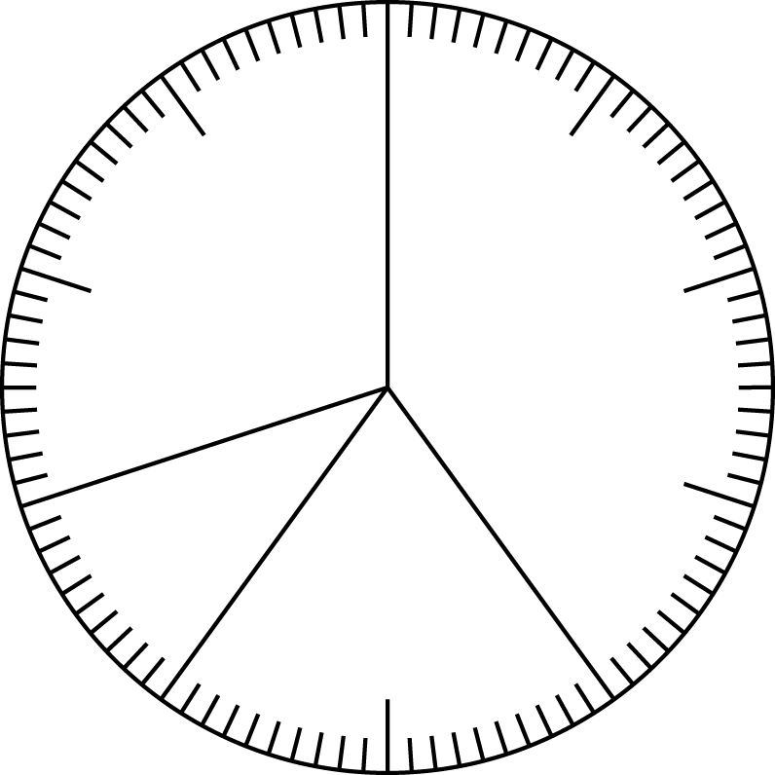
Preferred school visit
0%
(100%)
90%
10%
80%
20%
Seaside
Adventure Park
70%
Science
Museum
30%
Zoo
60%
40%
50%
Q1) What percentage of the pie chart is given to the Science Museum?
Q2) How many children chose a visit to the Science Museum if 60 pupils were surveyed in total?

Slide 8
Preferred school visit
0%
(100%)
90%
10%
80%
20%
Seaside
Adventure Park
70%
Science
Museum
30%
Zoo
60%
40%
50%
Q1) What percentage of the pie chart is given to the Science Museum? 10%
Q2) How many children chose a visit to the Science Museum if 60 pupils were surveyed in total? 6

