Slide 2
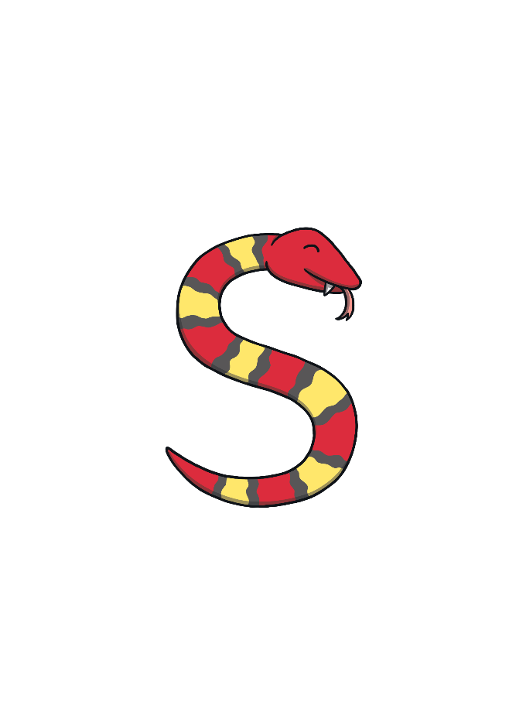
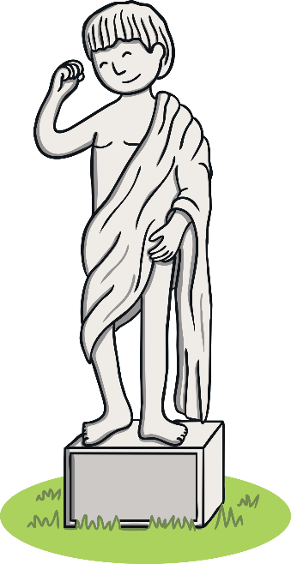
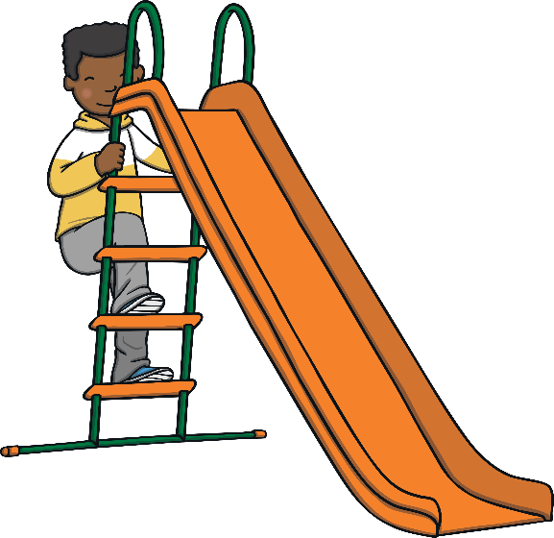
Revisit and Review
Let’s practise Sam’s Sounds and Common Exception Words!
oy
ue
e_e
ir
i_e
o_e
ay
u_e
ou
a_e
ie
ea
house
many
work
laughed

Slide 3
Teach
Today, we are learning to read words that contain ue for /yoo/.
X
ue can be found in the middle of a word or at the end of a word.
Click me for Kit’s teaching tips!

Slide 4
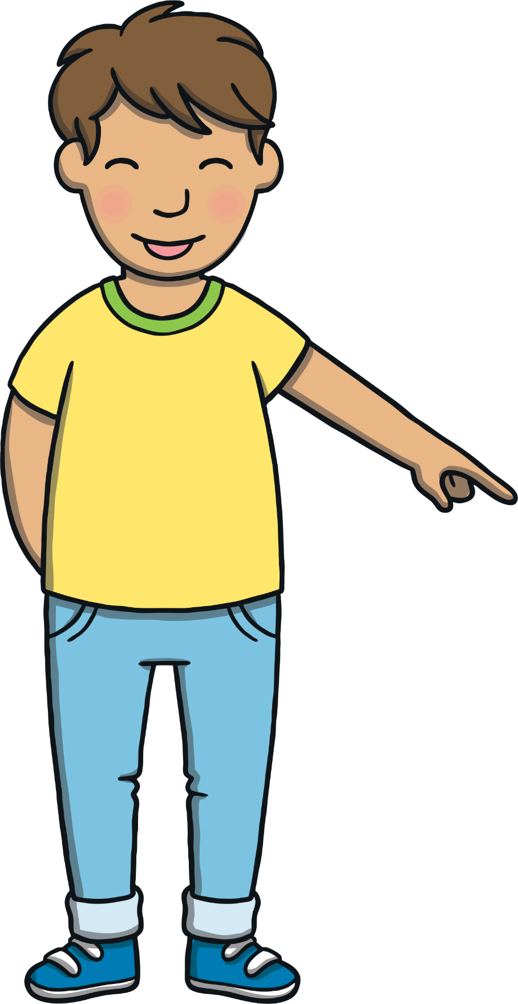
Revisit and Review
Let’s practise reading some of this weeks focus words that contain the ue sound.
due
venue
fuel
argue

Slide 5
Teach
This week, we are learning to spell the common exception words love and your.
Watch the magic pencil write the words. Can you join in?

Slide 6
Teach
d
u
e
Play

Slide 7
Teach
v
e
n
u
e
Play

Slide 8
Teach
f
u
e
l
Play

Slide 9
Teach
a
r
g
u
e
Play

Slide 10
Teach
As Dad drove through the open gates, Kit and Sam stared out of the car window. There was a huge statue stood at the side of the long driveway. “I wonder who he was?” Sam asked Kit.

Slide 11
Teach
Kit replied, “I have no idea! Maybe it is Sue’s new husband.” Everyone laughed!
Dad turned to Mum, “is this the right venue? There do not seem to be that many people here.”

Slide 12
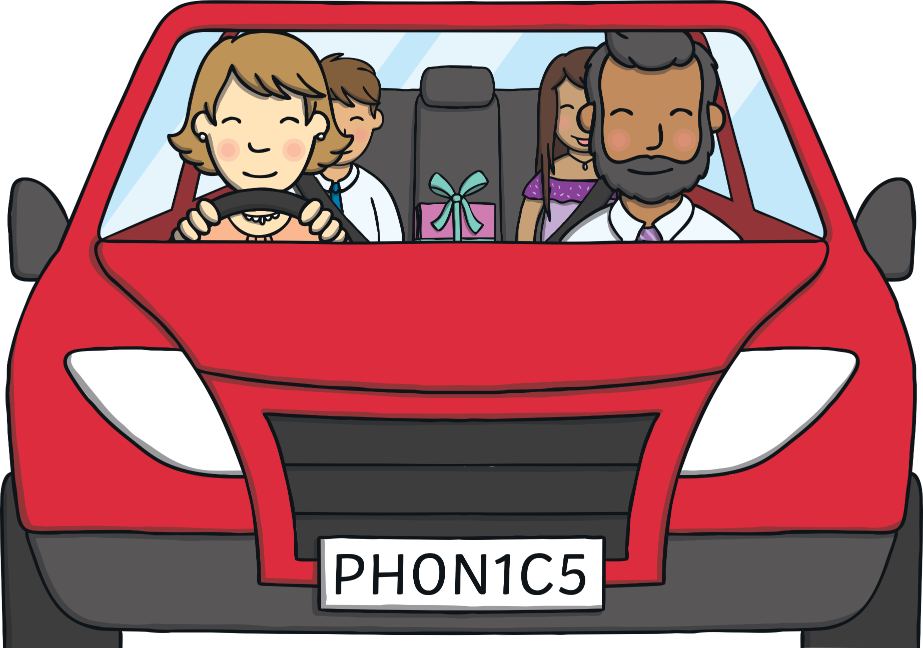
Teach
“We have arrived a little early. I thought it would have taken us longer to get here. People are due to arrive around eight o’clock,” replied Mum. She continued, “We could always visit the gardens first before we see Sue and her husband Mike.”

Slide 13
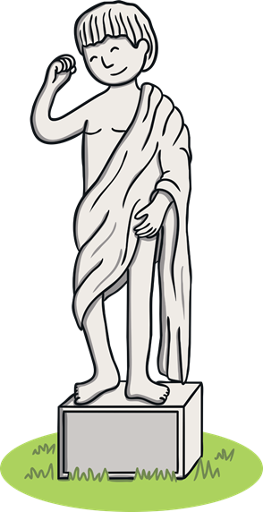
Statues in the Garden
Teach
Dad parks the car and the family explore the hotel gardens. There are lots of very old statues in the garden. Can you work out what the signs beside the statues say because some of the letters are missing?
Write down your answers.
X
They are all ue words.
Hint

Slide 14
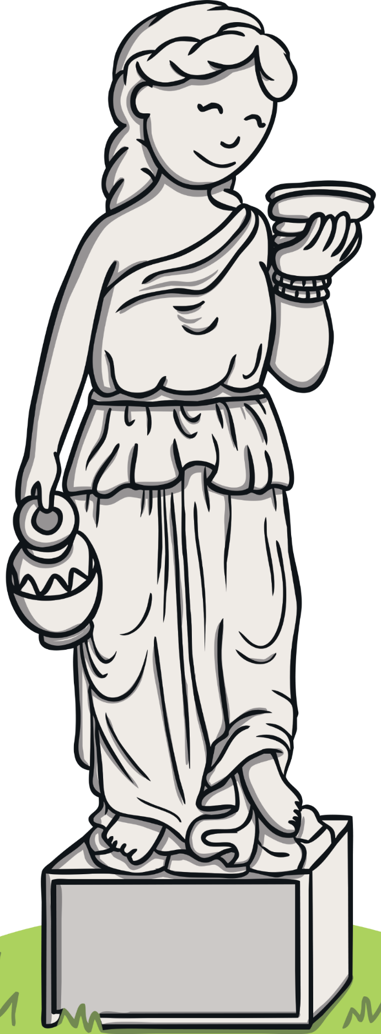
Teach
f l
ue
Check

Slide 15
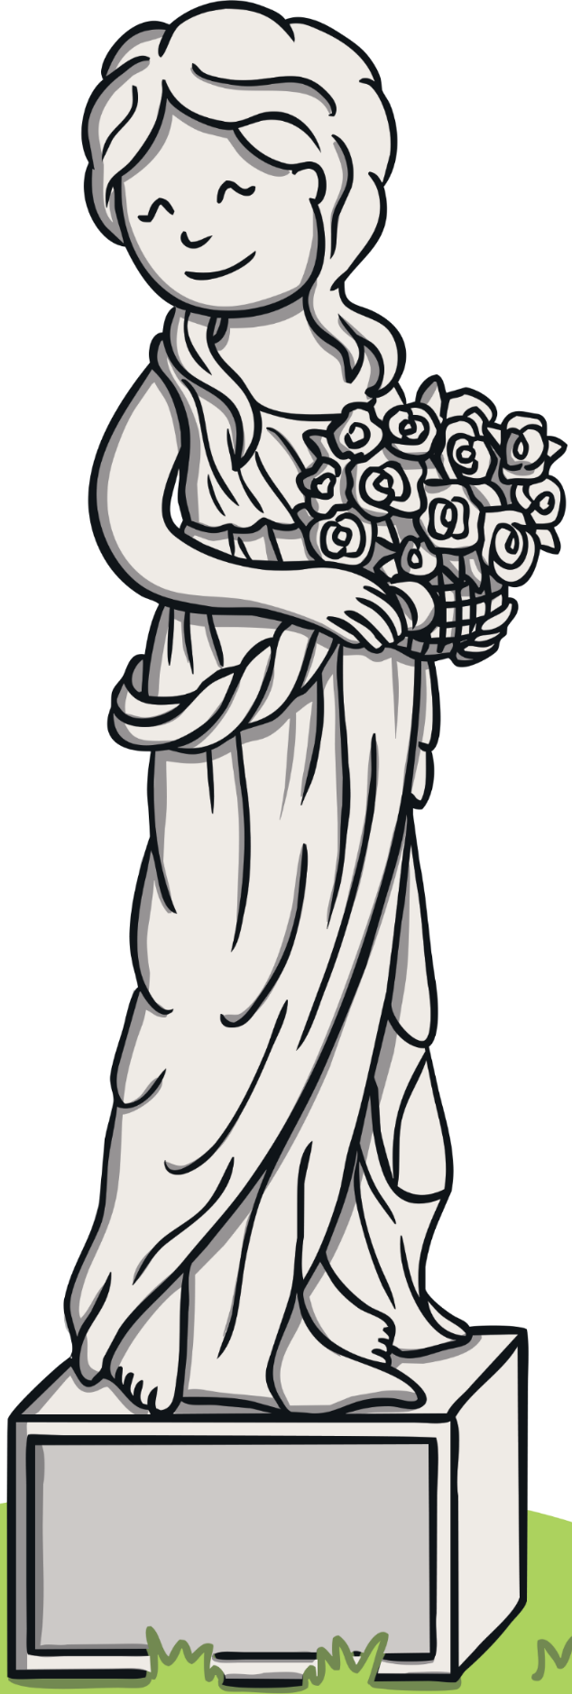
Teach
ue
d
Check

Slide 16
Teach
ue
arg
Check

Slide 17
Sundial Word Spin
Practise
Kit and Sam notice a sundial in the hotel garden. Click on the button to see which ue word is in the shade. Unfortunately the letters are jumbled up!
Write down each word.
X
The first letter of each jumbled word is the actual first letter of the word.
Hint

Slide 18
Practise
cue
ceu
value
vueal
pursue
statue
psurue
stueat
ruecse
rescue
Check
Spin

Slide 19
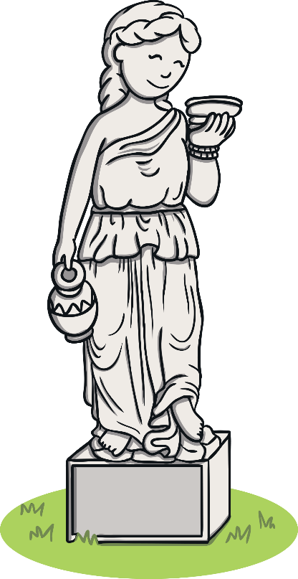
Apply
“I’m coming to rescue you two from that big statue!” joked Mum.
“Rescue us?” Kit and Sam laughed.
“It is time to go into the hotel because many more people have arrived,” said Dad.

Slide 20
Apply
“Dad, this garden is so beautiful!” Sam said, looking at the flowers. Dad nodded.
Mum added, “Maybe you will get a chance to come back out here later but now we are due to be inside.”

Slide 21
Sentence Time
Apply
What was Sam thinking to herself?
Read the sentence then click ‘Show’ to reveal the answer!

Slide 22
Apply
I have never seen so many statues!
Sound Buttons On/Off
Show

Slide 23
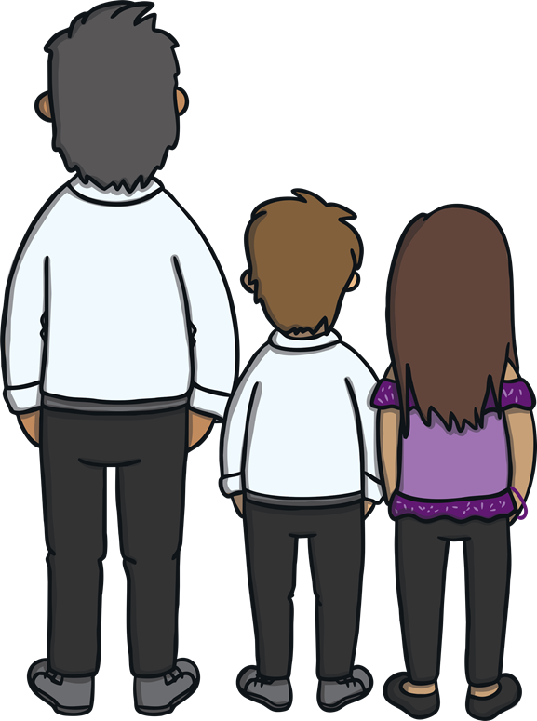
Apply
The family entered the hotel and were greeted by a friendly receptionist. “Welcome! Are you here for the wedding of Mr and Mrs Uba?”
“Yes,” Mum replied. “Where do we need to go?”

Slide 24
Apply
She responded, “Follow the signs for the Hampton Room. It is just around this corner and on your left.”
“Thank you!” replied Mum and Dad together.
“Time to party!” replied Kit. Everyone laughed!

Slide 25
Today, we have learnt…
ue
saying /yoo/
The adventure continues next lesson!

