Slide 1

Using Causal Conjunctions

Slide 2

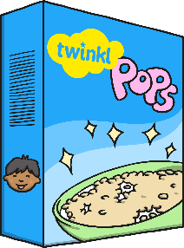
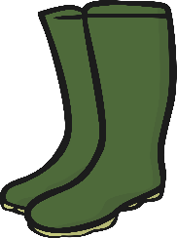
Causal conjunctions are used to explain how things work or why things happen.
I got soaking wet in the rain because I didn’t have my umbrella with me.
I didn’t have breakfast today, so I am really hungry now!
I am about to walk the dog hence my casual clothes and wellingtons.

Slide 3
Causal conjunctions can be:
Subordinating conjunctions
because
since
even though
as
now that
Coordinating conjunctions
so
yet
Adverbs/
Adverbials
accordingly
consequently
therefore
hence
as a result

Slide 4
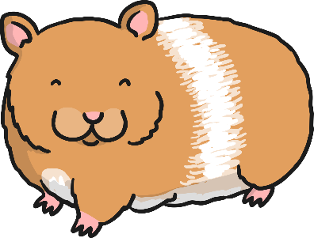
Top tip:
Use a comma before a coordinating conjunction if it links two independent, complete ‘thoughts’, i.e. clauses with a subject and verb in each.
For example:
My hamster loved to play, so I gave him a spinning wheel.
Here ‘so’ links two independent clauses.

Slide 5
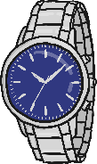

Causal conjunctions link clauses and can be used in the middle of a sentence.
My watch is not broken even though I dropped it onto the floor.
I don’t enjoy TV, so I have chosen to read tonight.

Slide 6
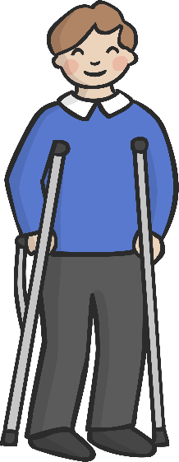
Causal conjunctions can also be used at the beginning
of a sentence to refer to the sentence before.
I dropped my watch on the floor. Consequently, it is broken.
Andy broke his leg recently. Accordingly, he is unable to ski at the moment.
The school heating is not working. As a result of this, the building is closed today.

Slide 7

Causal conjunctions which are also conjunctions can be used to link clauses in the middle or at the beginning of a sentence.
For example:
She is going to bed, so she won’t be tired tomorrow.
So she won’t be tired tomorrow, she is going to bed now.
Dad was late for work because he missed the train.
Because he missed the train, Dad was late for work.
Tom didn’t eat his sandwich as he wasn’t very hungry.
As he wasn’t very hungry, Tom didn’t eat his sandwich.

Slide 8

Using Causal Conjunctions Quiz

Slide 9
Causal Conjunctions can be:
Subordinating conjunctions
Coordinating conjunctions
all three
adverbs/adverbials
all three

Slide 10
Which sentence uses a
conjunction accurately?
We are going for a picnic the weather is so nice.
Since the weather is so nice, we are going for a picnic.
Since the weather is so nice, we are going for a picnic.
The weather is so nice since we are going for a picnic.

Slide 11
Which sentence uses a
conjunction accurately?
I visited the British Museum. I am interested in History.
I visited the British Museum I am interested in History because.
I visited the British Museum because I am interested in History.
I visited the British Museum because I am interested in History.

Slide 12
Which causal conjunction is missing?
As a result of
because
Therefore
as
Consequently
her injury, Sandy had to withdraw from the swimming competition.
The brakes do not work. the car is unsafe to drive.
I am wearing sunscreen today it is very hot.
Our teacher is not in school today he is ill.
Sal revised carefully. , she did well in her exams.
As a result of
Therefore
as
because
Consequently

