Slide 1


Let’s Keep to the Point!
An informative PowerPoint about
punctuating bullet points consistently

Slide 2
LO: to punctuate bullet points consistently
Success Criteria:
I know that bullet points can be used for several purposes.
I can say when my bullet points contain sentences or proper nouns.
I use capitals, full stops and question marks in my bullet points appropriately.
I know when I can use : and ; in a bullet list.

Slide 3
Where do you find bullet points?
Bullet points are little markers at the start of a line which are used to separate items in a list. For example, you might be listing names in a class or team. In addition, it could be a shopping list, notes taken from a presentation, a list of questions or the resources needed for your science investigation.
Buy:
butter;
milk;
bread;
tea bags;
Sausages;
frozen peas.
Netball team
Jamie D
Stefano
Alex
Katie W
Kodi
Maia
Izzie
Elephants
biggest land mammals
weigh > car
African bigger than Asian
trunk = nose
tusks = v long teeth

Slide 4
Why use bullet points?
Bullet points, like numbered lists, help to break down a set of key ideas or items so that the reader can see them all easily. We use bullets instead of numbers when the items in the list don’t need to go in any particular order.
Let’s try again…
We can see bullet points in lots of places, such as:
shopping lists;
names in a class or team;
presentation notes;
survey questions;
science resources list.
An introduction phrase or title for the list is often called the stem.
Make sure each point is clearly different from the others.
Bullet points don’t have to be dots, but they should all be the same in one list.

Slide 5



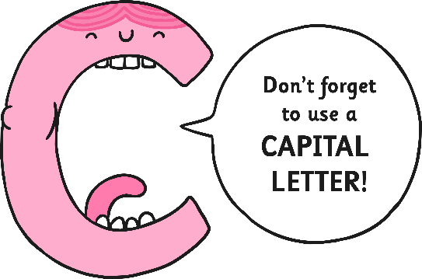

Punctuating Bullet Points
Why do we need punctuation in a bullet point list? Aren’t the bullet points the punctuation?
Well, no – they’re just a way of laying out your information more clearly for the reader.
However, the information on some bullet point lists needs to follow specific punctuation rules.
Let’s take a look…

Slide 6
Listing Facts
You could put some individual facts about a topic into a bullet point fact box, for example in a report.
Facts are usually given as statements in a sentence. And what does a statement sentence always need?
That’s right – capital letter and full stop.
Fascinating Space Facts
Because of Mars’s lower gravity, you would weigh less there than you do on Earth.
Venus spins in the opposite direction to the other planets.
Uranus takes 84 Earth years to orbit the sun.

Slide 7
Listing Questions
A bullet point list is a good way to organise a set of questions you want to ask – tick them off as you go through.
Questions are typically in sentences, so they need a
capital letter and question mark.
Questions for Queen Victoria
How many children do you have?
Which is your favourite palace?
Do you like riding in your carriage?
Have you got any pets?
Why have you got a smaller crown than the kings and queens before you?

Slide 8
Listing Proper Nouns
When you make a list of names, for example people in a team or countries of the world, each name must have a
capital letter at the start.
Six largest countries in the world:
Russia;
Canada;
USA;
China;
Brazil;
Australia.
Netball team
Jamie D
Stefano
Alex
Katie W
Kodi
Maia
Izzie

Slide 9
Listing things or items
A bullet point list is a really clear way to show a set of resources or equipment needed.
These items are usually just words or phrases, so they don’t need sentence punctuation.
stem
If your list has a stem followed by a colon, each item needs a semi-colon except the last, which has a full stop.
You will need:
tea bags;
milk;
water;
kettle;
mug;
teaspoon;
sugar.
colon
Football tournament
blow-up goalposts
footballs
cones
whistles
stopwatches
You don’t have to use : and ; in your list of items. The most important thing is to be consistent. Stick to one style only in each list.
semi-colon
full stop

Slide 10
Just taking notes?
Bullet points are great for keeping your notes separate when you are researching a topic. If a set of points are just being jotted down for your own reference, you don’t need to worry about grammar, spelling and punctuation; it’s only your notebook after all!
Elephants
biggest land mammals
weigh > car
African ele bigger than Asian
trunk = nose
tusks = v long teeth

Slide 11
Your turn!
Look at the lists you’ve been given. Can you decide what sort of punctuation
(if any) each list needs?

Slide 12
Plenary
What have we learned about punctuating bullet points?
When bullet points mark a list of statements, we use capital letters and full stops.
If the list is a set of questions, we use capital letters and question marks.
Proper nouns always need capital letters.
Lists of items can have:
  no punctuation at all;
  OR
  colon, semi-colons and full stop.
BE CONSISTENT!

Slide 13


